Slide 1
Second Life – The Lower Limb
A walk through detailing the bones, muscles, arteries, veins, lymphatic system, and innervation of the leg.

Slide 2
Second Life – The Lower Limb
The Lower Limb will be presented in three different modules:
The Thigh
The Lower Leg
The Foot
Within each module relevant structure of bone, muscle, nerve innervation, arterial and venous supply and lymphatic system will be described as a unit.

Slide 3
Second Life – The Lower Limb
Atlas of Anatomy images are Copyright ©2008 by Thieme. All rights reserved. Illustrators: Markus Voll & Karl Wesker
Human Anatomy base reference for text Copyright ©2005 by Saladin. All rights reserved. McGraw-Hill Companies, Inc.

Slide 4
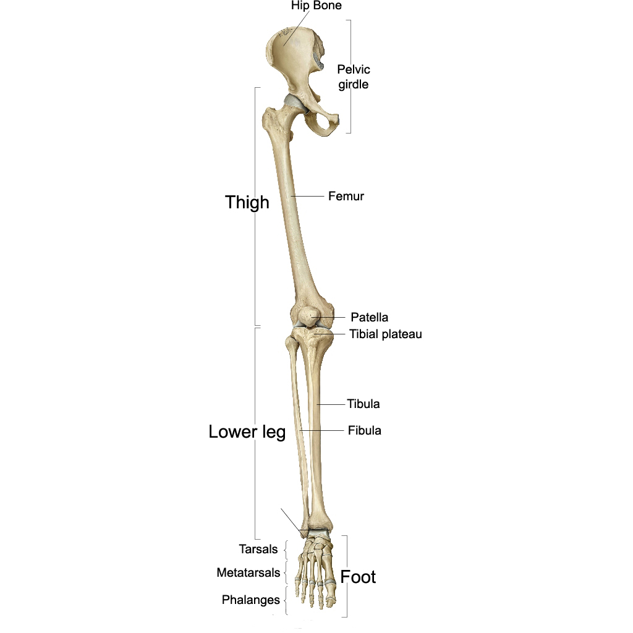
Distinct Regions of the Lower Limb
The Lower limb in subdivided into three regions: Thigh, Lower Leg, and Foot.
These regions comprise the entire lower limb, which is attached to the body at the pelvic girdle.
We will take an in-depth look at each of these three distinct lower limb regions. First let’s begin by understanding the structure and function of the leg.

Slide 5
The Femur
The lower limb is very similar to the upper arm in many ways yet has a more restricted range of motion. While the arm is built for movement, the leg is built for stability.
We will begin by covering the surface anatomy of the Femur. Understanding the features of this bone will provide the foundation for learning about the rest of the leg.
Only one bone composes the thigh: the femur.
There are several muscles that act on the femur that allow for such a complex movement as bipedal walking. Before we look at the muscles of the thigh, there are numerous features that make up the femoral surface.

Slide 6
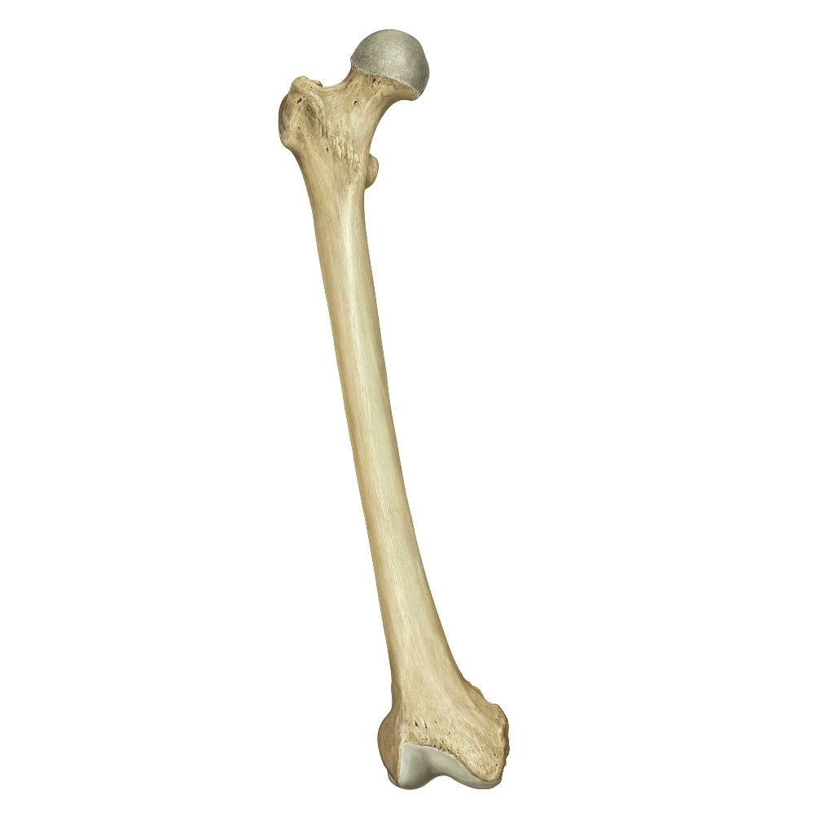
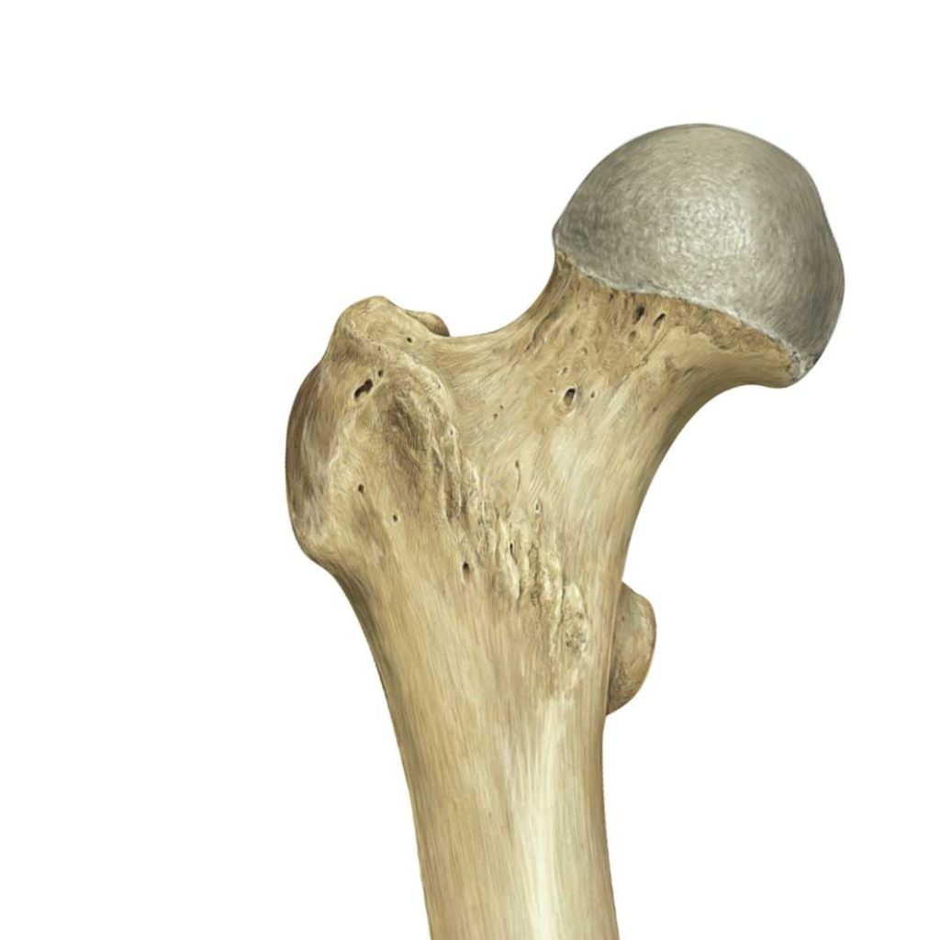
Right Femur:
Anterior View
Proximal Features of the FEMUR:
Head
The femur is the longest bone in the human body and is responsible in bearing the most weight. The proximal end of the femur consists of two major tuberosities, a constricted neck and its hemispherical head where it articulates with the pelvis in a ball-and-socket joint.
The anterior processes and bony ridges in which the powerful muscles of the hip attach, include the greater and lesser trochanters (tro-CAN-turs) and intertrochanteric line.
Greater Trochanter
Neck of Femur
Lesser Trochanter
Intertrochanteric Line

Slide 7
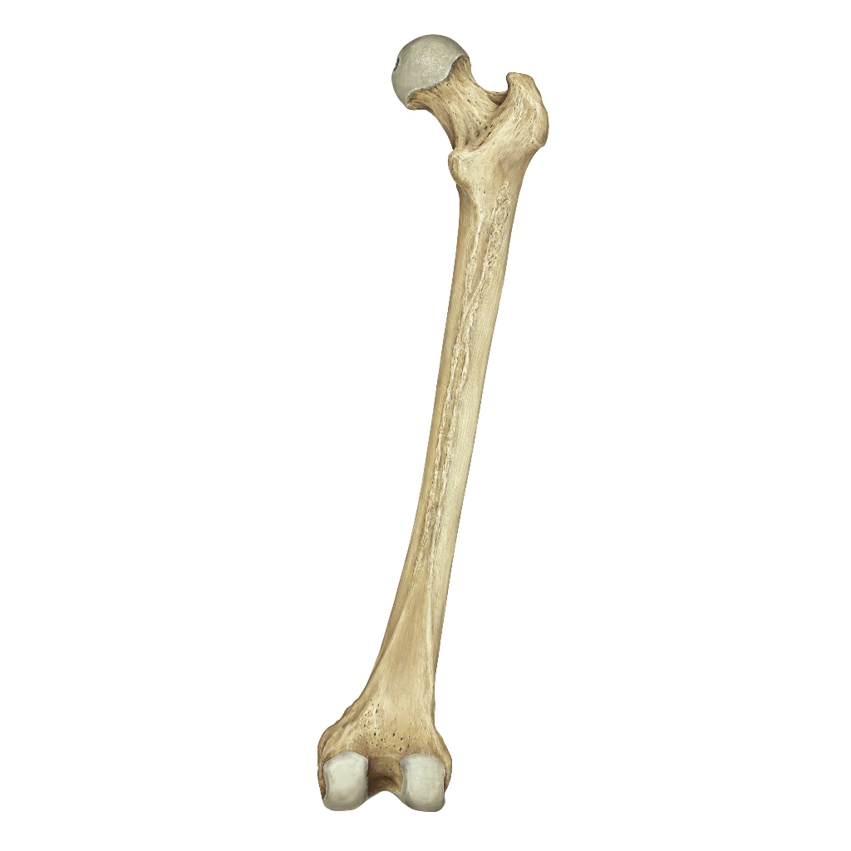
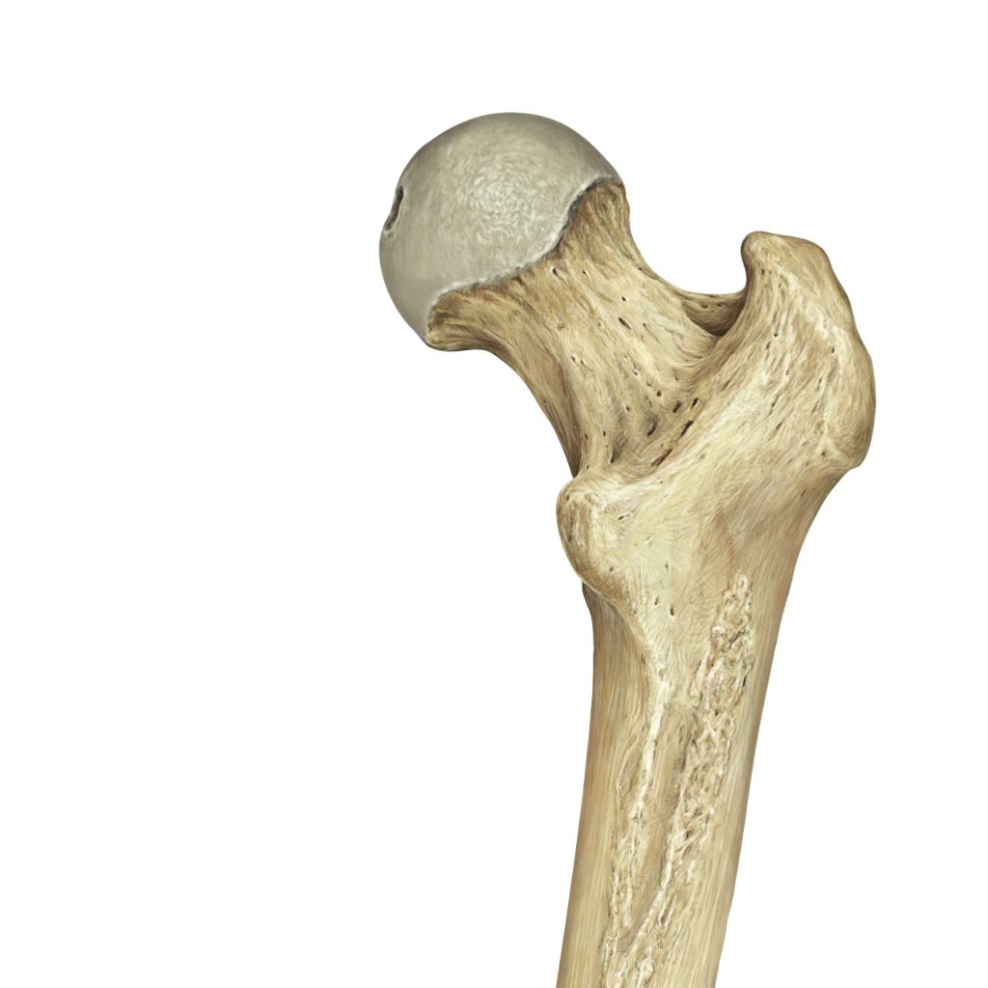
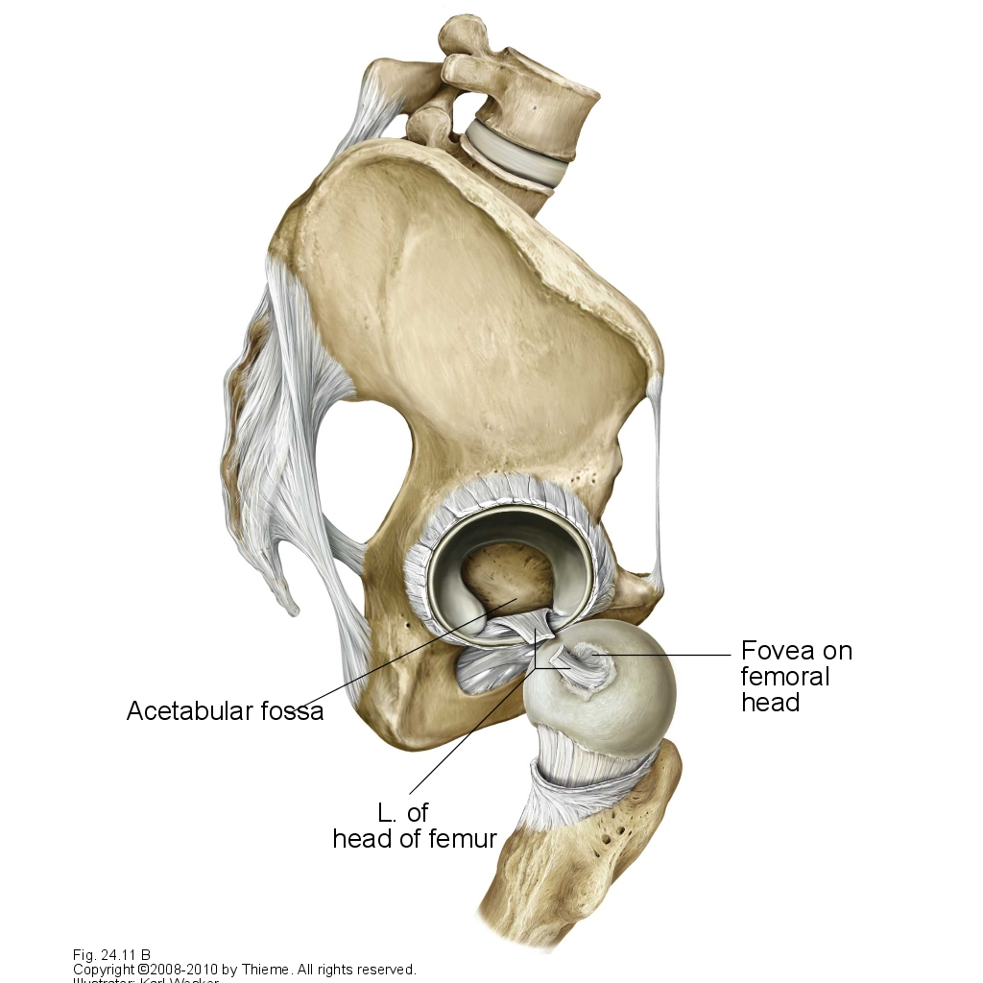
Right Femur:
Posterior View
Proximal Features of the FEMUR:
Intertrochanteric Crest
On the posterior portion of the femur is the intertrochanteric crest.
The fovea captis is also slightly viewable from the posterior side of the femur. It is at this pit that the Ligament of the of the Head of the Femur attached the femur to the hip as well as delivering part of the femur’s blood supply.
Fovea captis

Slide 8
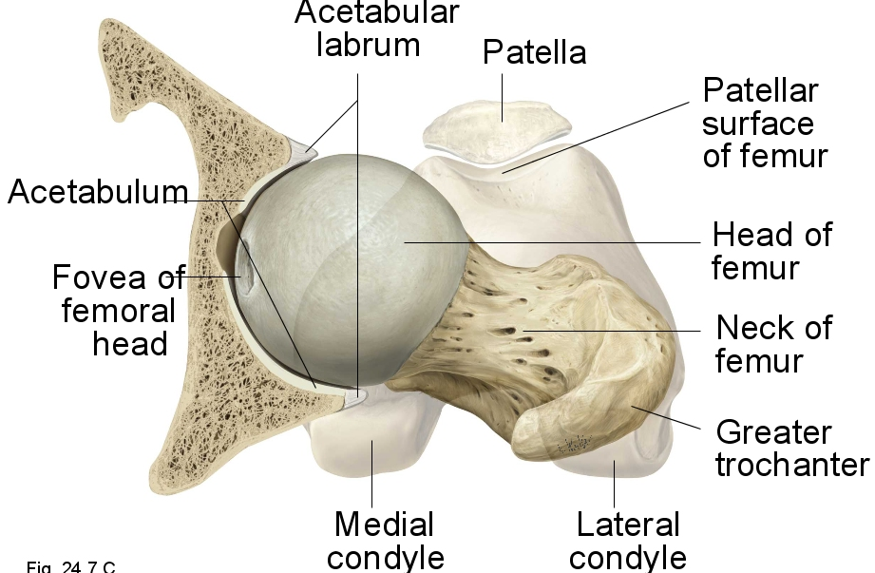
The Hip Joint
The head of the Femur articulates at the acetabulum of the hip bone.

Slide 9
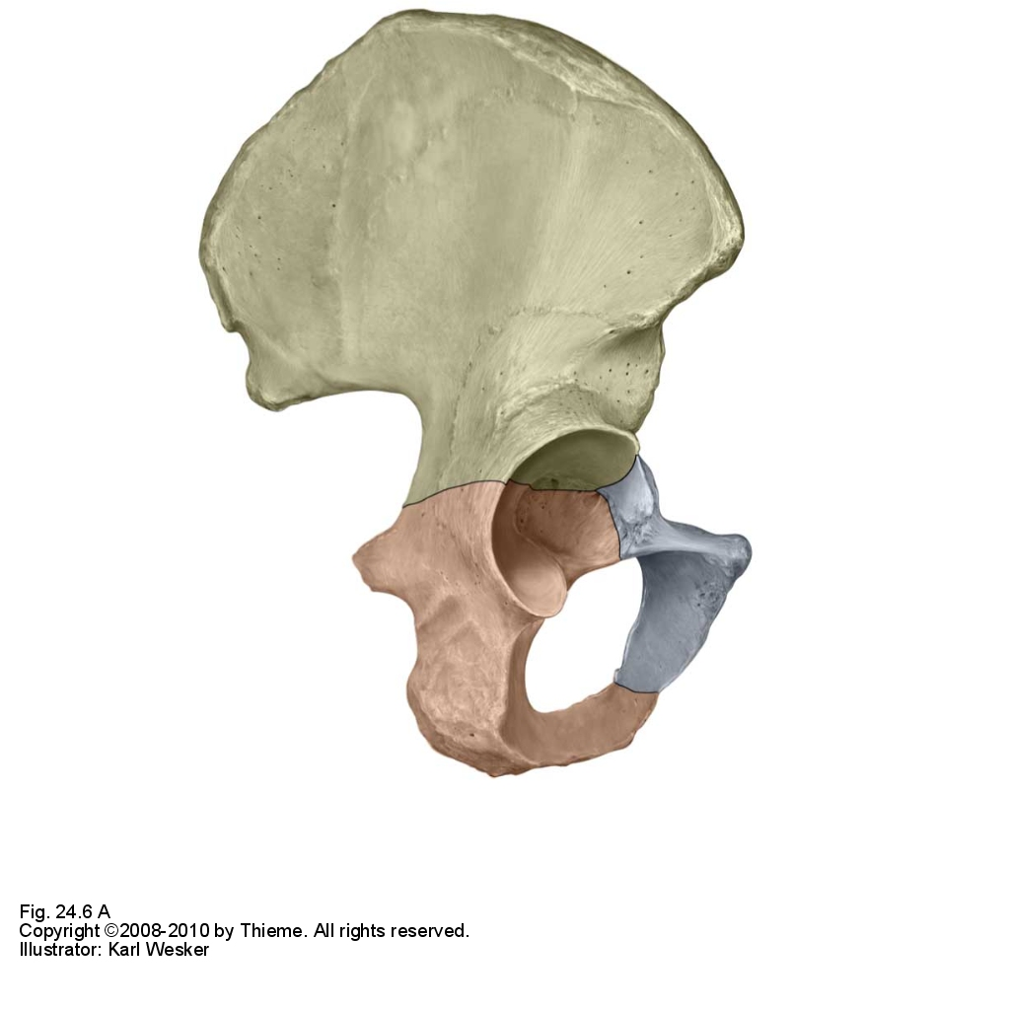
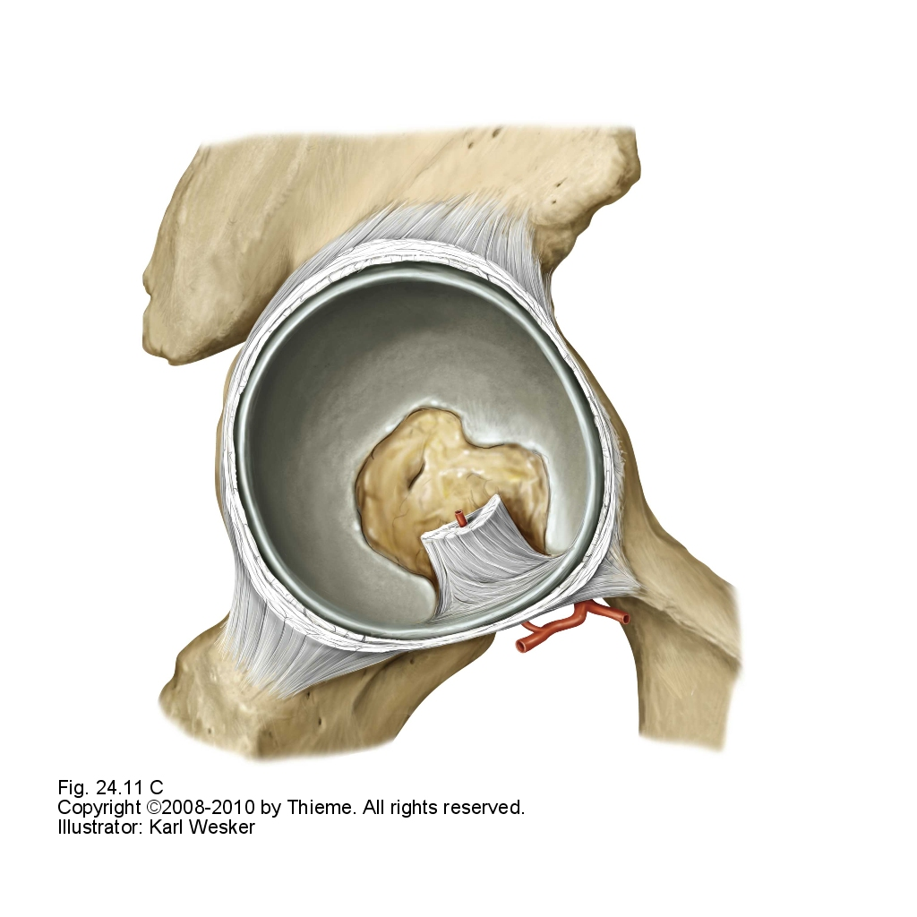
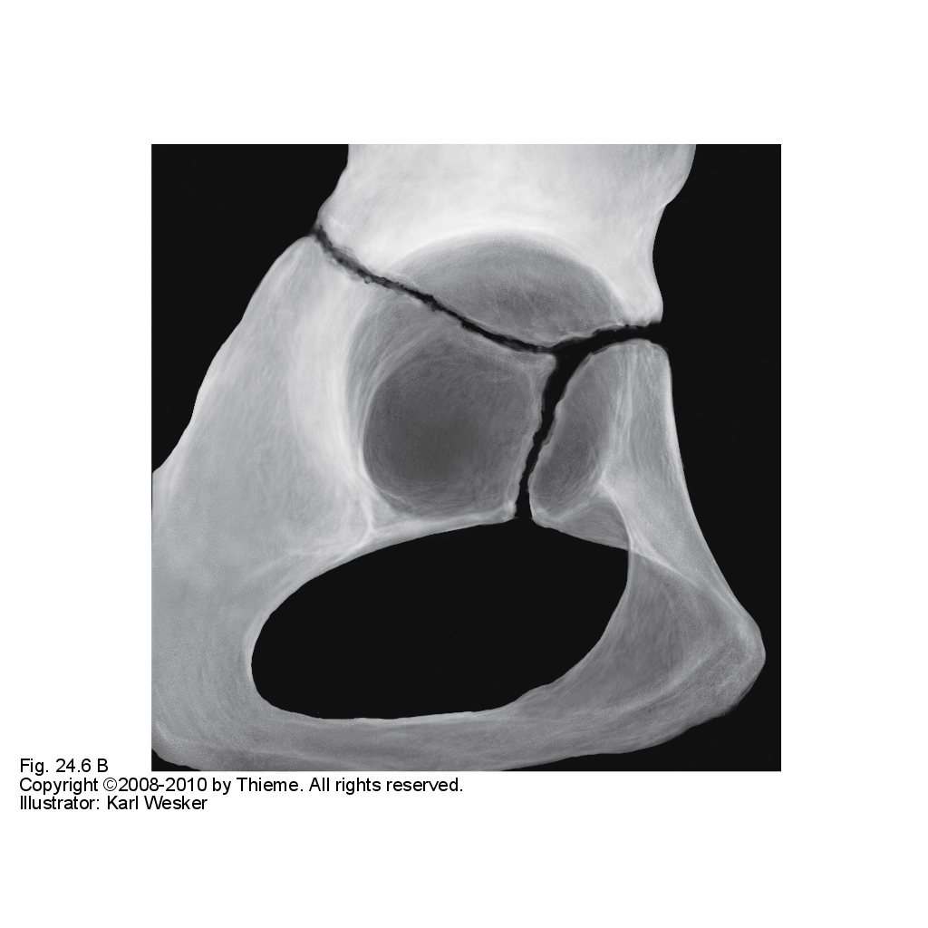
The Hip Joint: Acetabulum
Illium
The acetabulum is located at the intersection of three bones that fuse between the ages of 14 to 16. These three bones include the illium, ischium and pubis. It is at this point that the femur articulates with the hip and is connected by multiple ligaments
Acetabular rim
Acetabular labrum
Ischium
Lunate surface
Acetabular Fossa
Pubis
Obturator artery
Main source of blood to the femoral head
Fig 24.11C Acetabulum

Slide 10
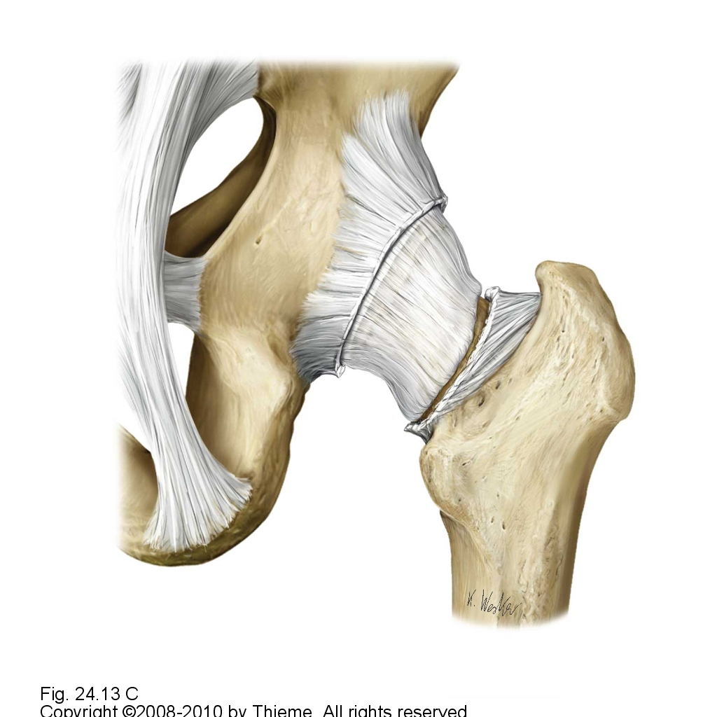
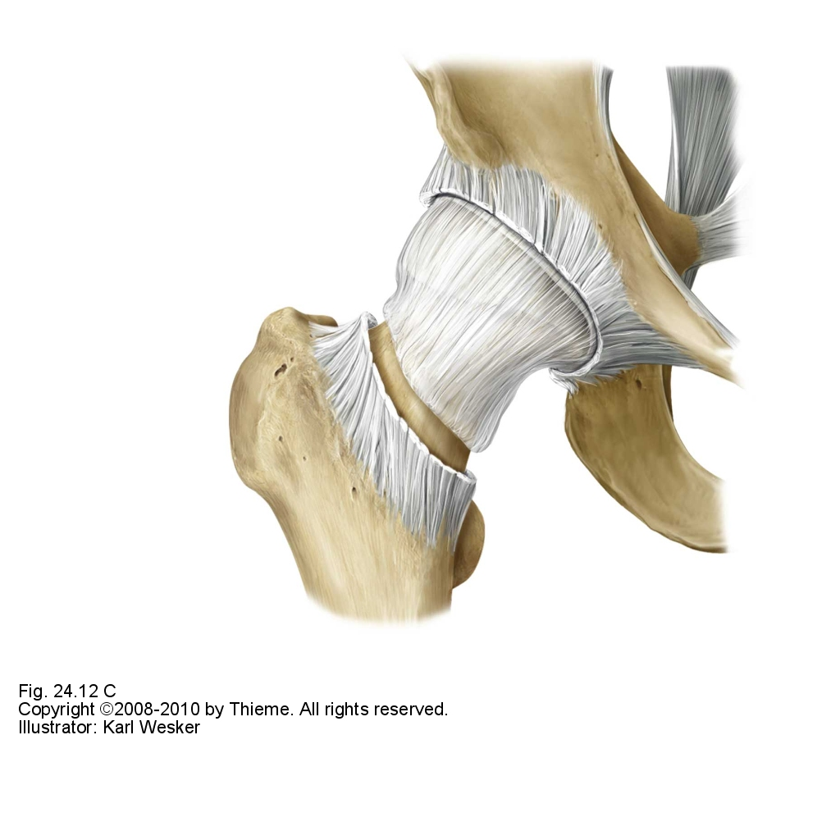
The Hip Joint: Ligaments
Right Hip:
Posterior View
Right Hip:
Anterior View
Fibrous membrane
Synovial Membrane
Intertrochanteric line
Like the shoulder joint, the hip joint is a ball and socket joint. There are a many more ligaments reinforcing the hip compared to the shoulder because the hip is responsible for keeping the body in an upright position while standing. This increase in number of ligaments makes the hip more stable in comparison to the shoulder, yet with a smaller range of motion.

Slide 11
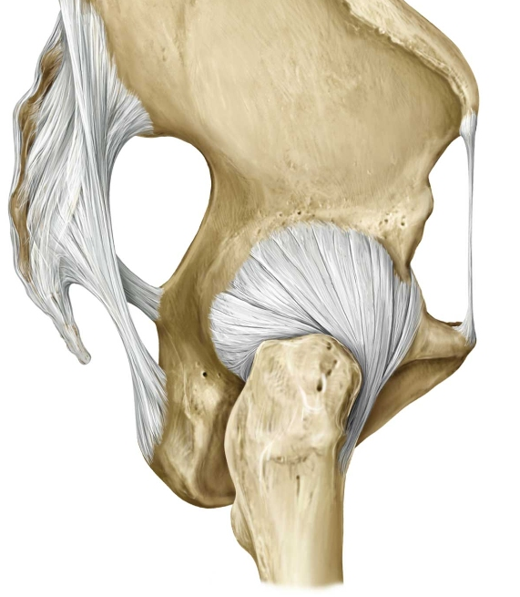
Right Hip:
Lateral View
The Hip Joint: Ligaments
Posterior
Anterior
The hip joint is encapsulated by a synovial membrane and held together by 4 ligaments. Three of the four ligaments are extracapsular and one is intracapsular.
The extracapsular ligaments include the ilifemoral ligament, ischiofemoral ligament and pubofemoral ligament which are attached to proximally to the iliac, ischium and pubis respectively.
The intracapsular ligament attaches the fovea captis of the femur to the acetabulum and is identified as the transverse ligament of acetabulum.
Iliofemoral ligament
Pubofemoral ligament
Ischiofemoral ligament
Weak spots, where tearing is more common, are marked in red.

Slide 12
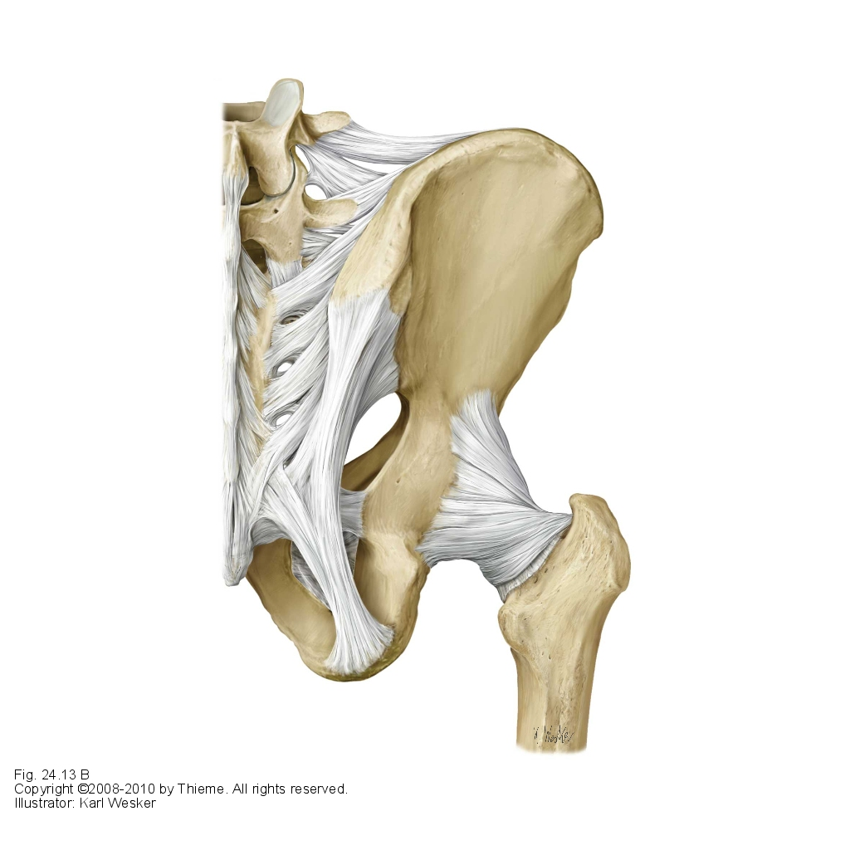
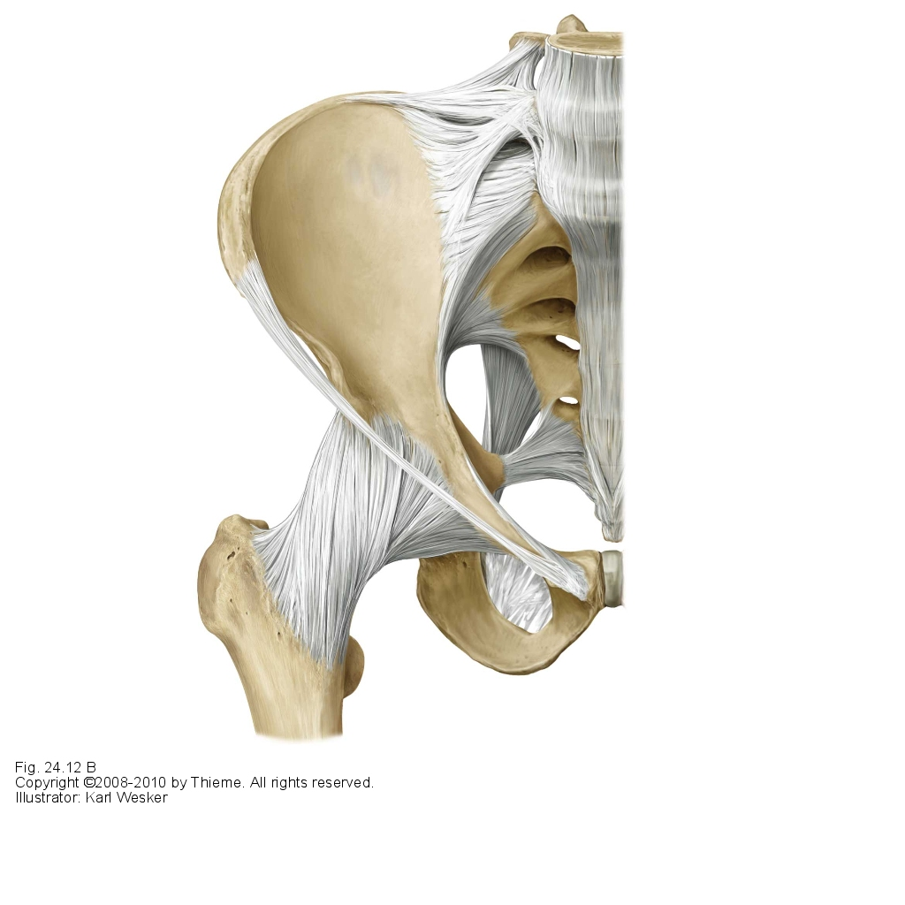
The Hip Joint: Ligaments
Right Hip:
Posterior View
Right Hip:
Anterior View
Iliofemoral ligament
Pubofemoral ligament
Ischiofemoral ligament
The iliofemoral ligament is the strongest ligament in the body and keeps the torso in an upright position while standing without the need of muscular contraction.

Slide 13
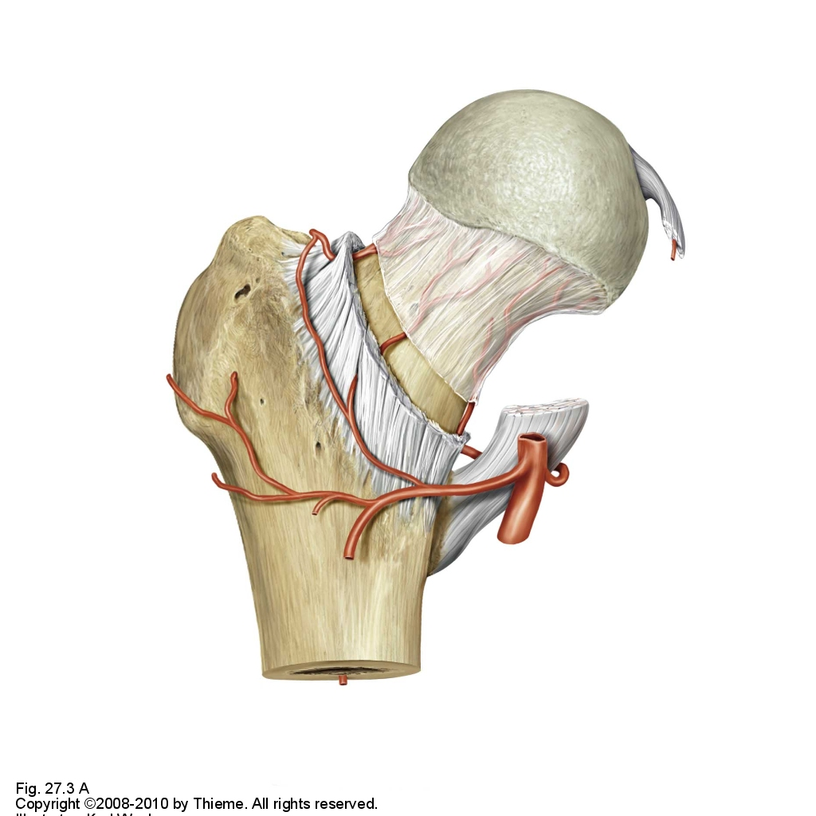
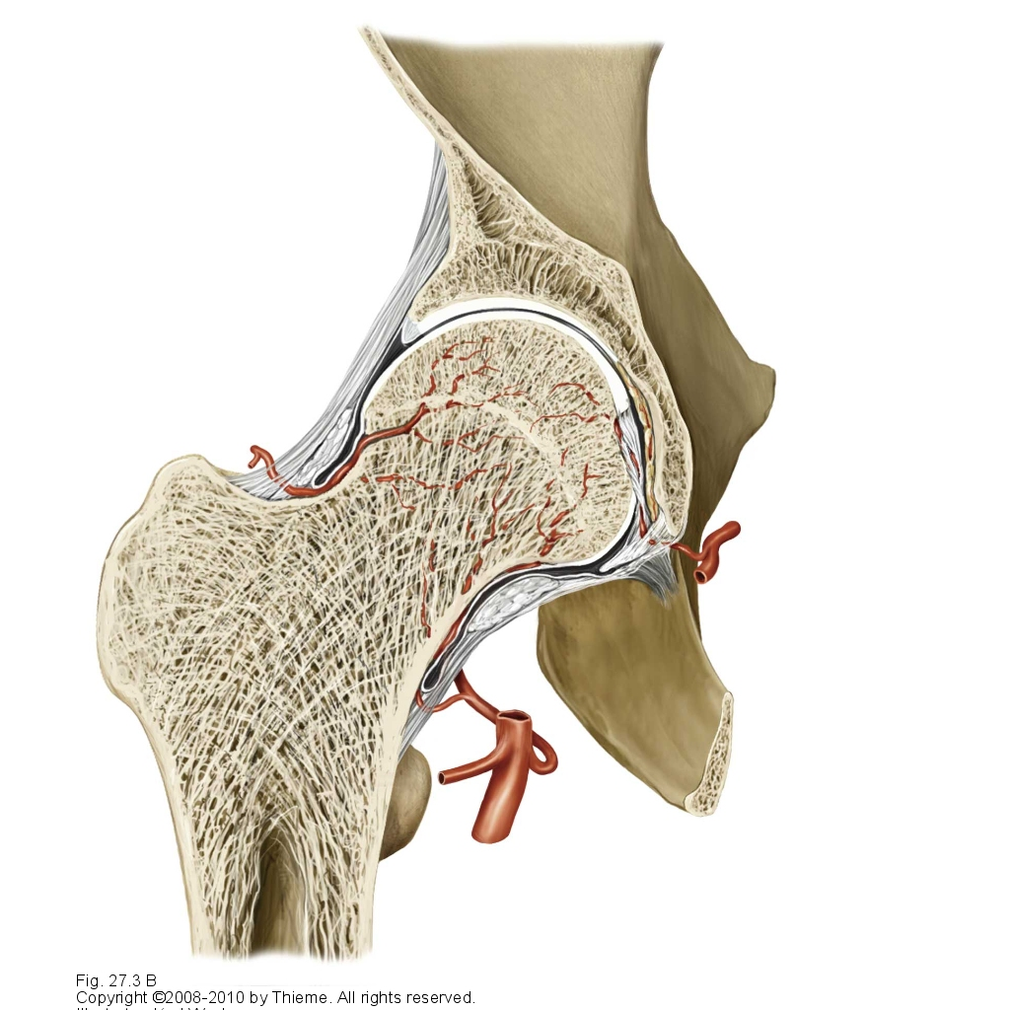
Femoral Head Blood Supply
The femoral artery along with the obturator artery deliver blood to the head of the femur.
Any separation or damage to the neck of the femur can lead to femoral head necrosis.
Femoral artery
Obturator artery

Slide 14
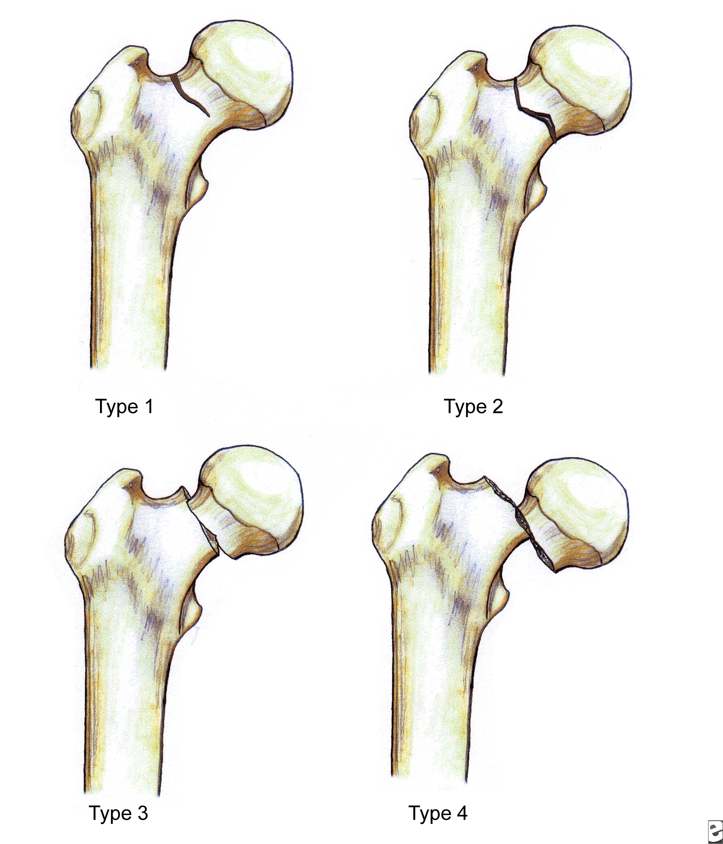
Clinical: Femoral Neck Fractures
Femoral neck injuries are one of the major injuries that can occur to the femur. They are most common in senior citizens due to osteoporosis yet can be seen with victims of a motor vehicle collision. Femoral Neck Fractures are commonly classified as non-displaced or displaced depending on the degree of the head’s displacement.
Non-displaced
Displaced
http://emedicine.medscape.com/article/86659-overview

Slide 15
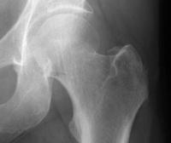
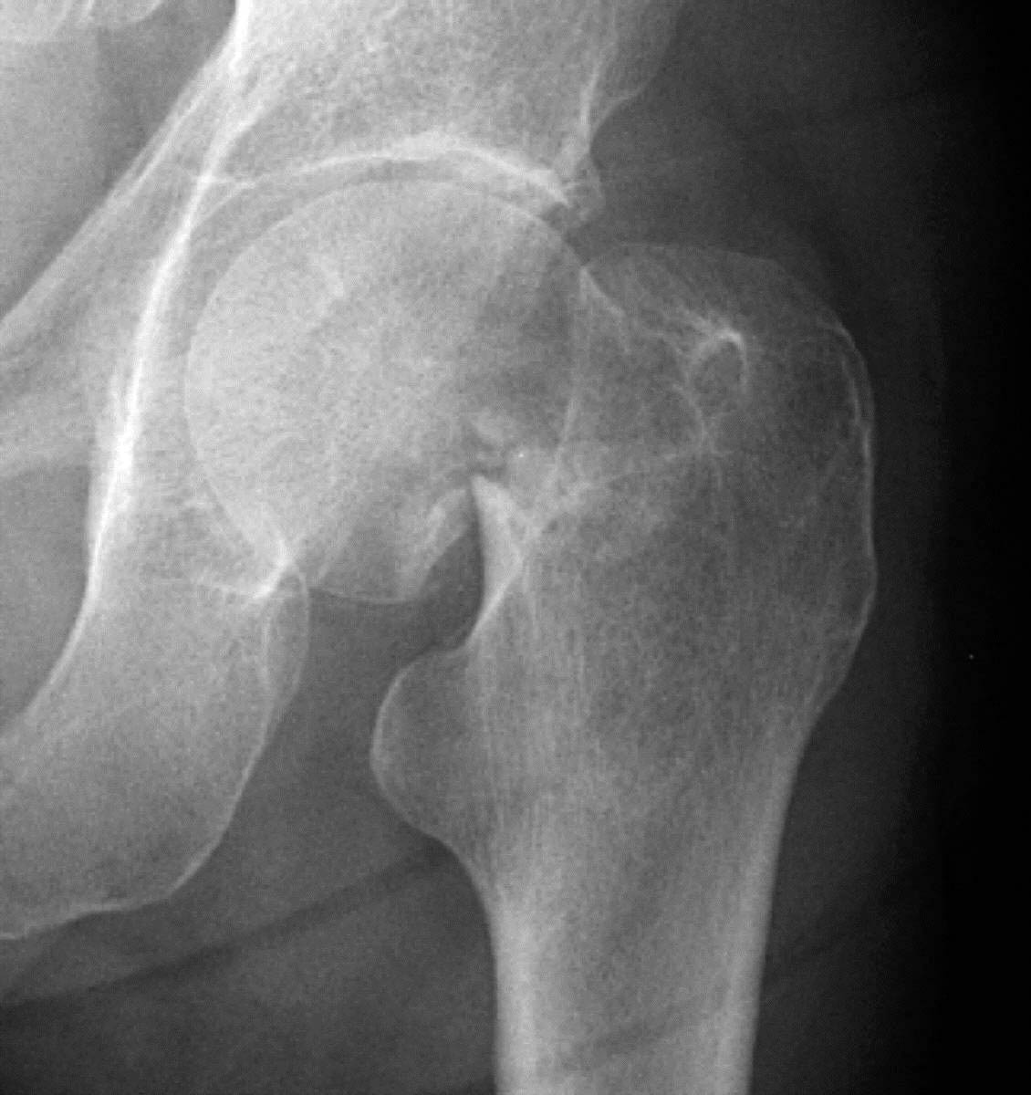
Clinical: Femoral Neck Fractures
Non-Displaced
Displaced
http://emedicine.medscape.com/article/390598-overview

Slide 16
The Shaft of the Femur
Lesser gluteal tuberosity
One of the femur’s predominant features is the linea aspera, a ridge that splits proximally into the pectineal line (spiral line) and lesser gluteal tuberosity. Distally, the linea aspera divides to form the lateral and medial supracondylar lines.
Pectineal line
Linea aspera
Lateral lip
Medial lip
Medial supracondylar line
Lateral supracondylar line

Slide 17
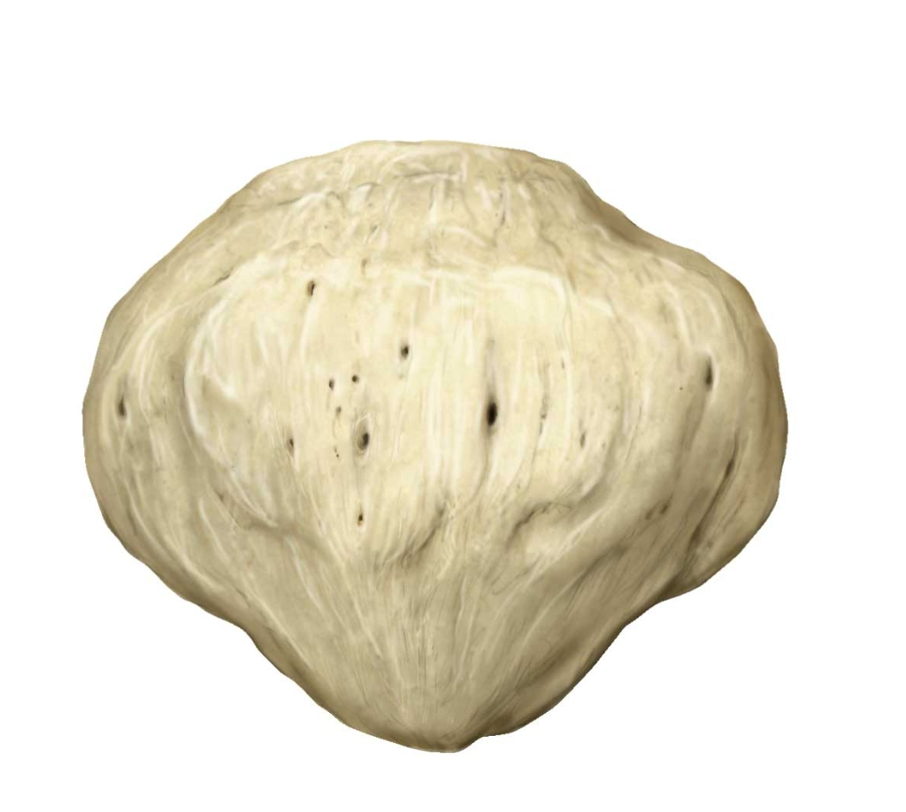
Right Femur:
Anterior View
Distal Features of the FEMUR:
The distal end of the femur articulates with the fibula and tibia of the lower limb at the knee joint.
The medial and lateral condyles are joined at a surface known as the patellar surface, then split posteriorly.
Adductor tubercle
Medial epicondyle
Lateral epicondyle
Lateral condyle
Patellar surface
Medial condyle

Slide 18
Right Femur:
Posterior View
Distal Features of the FEMUR:
The distal end of the femur has 3 points in which it articulates with other bones. The two condyles (medial and lateral) articulate with the tibia at the knee joint. The patellar surface articulates with the patella.
The fibula is not involved in the knee joint and does not make contact with the femur yet the fibular collateral ligament does attach the two, adding stability to the knee joint.
Adductor tubercle
Lateral epicondyle
Medial epicondyle
Intercondylar
notch
Lateral condyle
Medial condyle

Slide 19
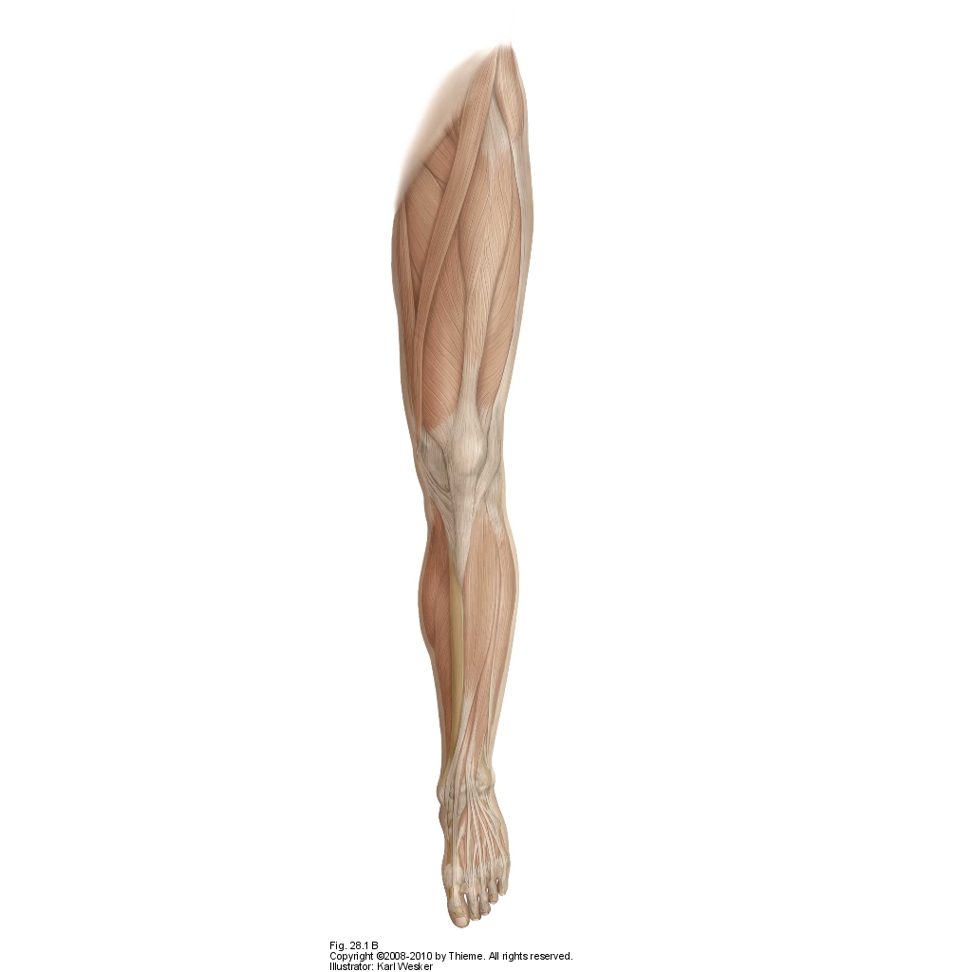
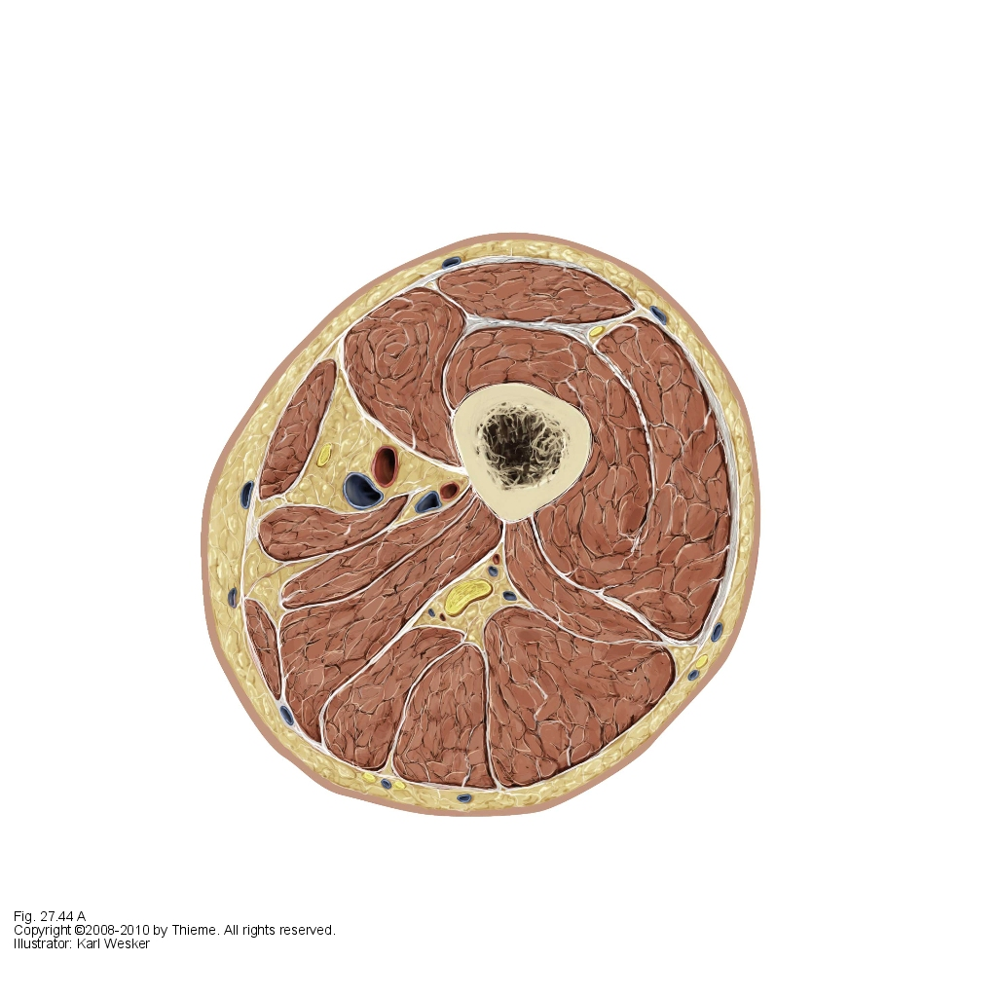
Cross Section of the Thigh
The facia extends inward to separate the thigh into anterior, posterior and medial compartments.
The anterior compartment consists of the thighs primary flexors. The posterior compartment consists of the thighs primary extenders. The medial compartment consists of the thighs primary aDductors.
Anterior
Compartment
Medial
Comp.
Posterior
Compartment

Slide 20
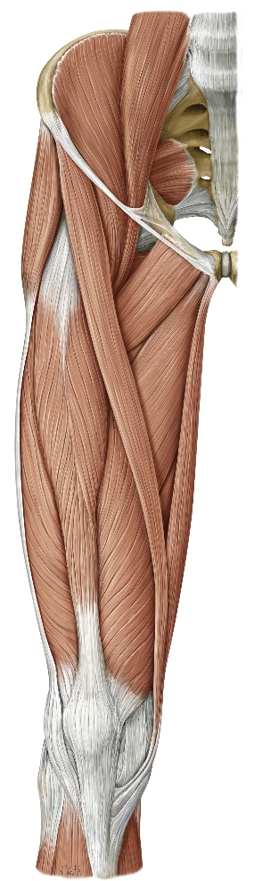

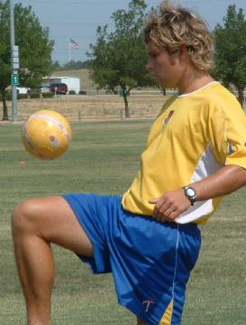
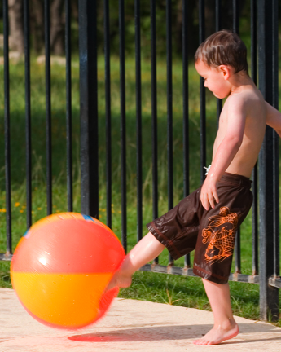
Muscles of the Thigh: Anterior
The muscles of the thigh are divided into an anterior and a posterior section. The anterior section consists of majority flexors innervated by the femoral nerve, including the sartorius and the quadraceps femoris.
The sartorius is the lateral edge of what is known as the femoral triangle. It rests on top of the adductor canal and is commonly used in surgical practice as a guide to locating the femoral artery. It serves to flex, aBduct and externally rotate the hip joint and flex and internally rotate at the knee joint. It’s this internal flexion and rotation that aids in sitting cross-legged.
The quadraceps femoris muscles allow for flexion at the hip joint and extension at the knee as when juggling (bouncing) and kicking a soccer ball. These muscles are very important in running and are exercised while performing squats.

Slide 21
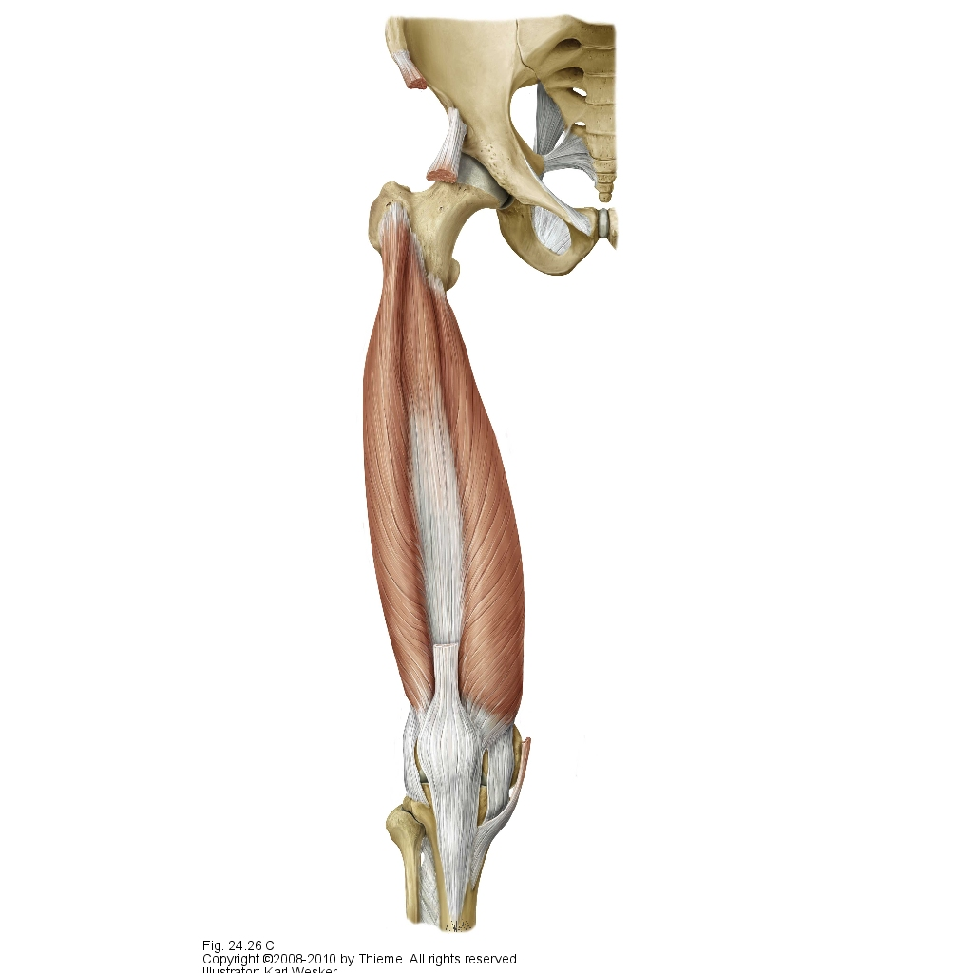
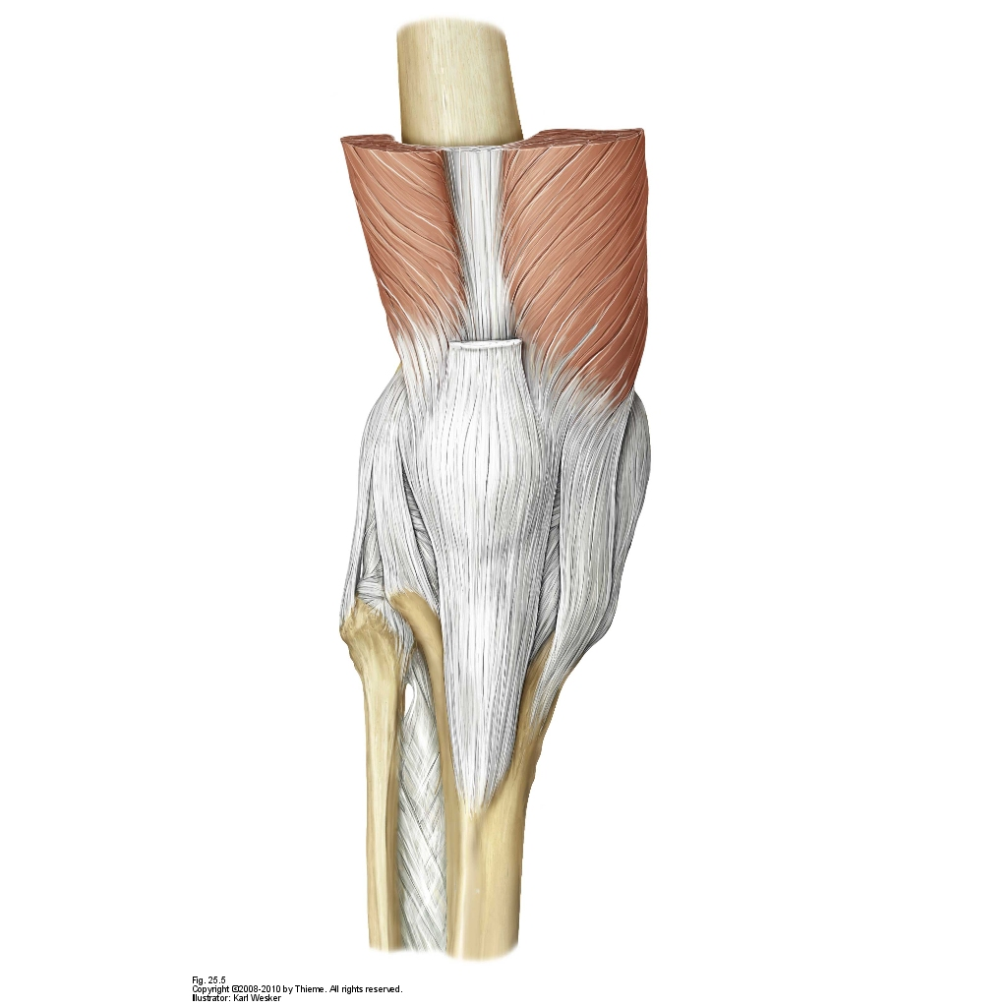
Muscles of the Thigh:
Anterior
Rectus femoris tendon
Vastus intermedialis
The quadraceps femoris is a collection of four muscles including the rectus femoris and the 3 vasti (lateralis, medialis and intermedialis) The rectus femoris runs along the femur to the tibia and aids the iliopsoas in flexion of the thigh as well as extension of the leg.
These four muscles merge at the quadracep femoris tendon, at the point in which it embeds the patella then continues downwards towards the foot, taking on the name patellar ligament.
When testing reflexes of the lower spine, it is the patellar ligament that is tapped and the quadraceps femoris contracted.
Vastus medialis
Vastus lateralis
Patellar ligament

Slide 22
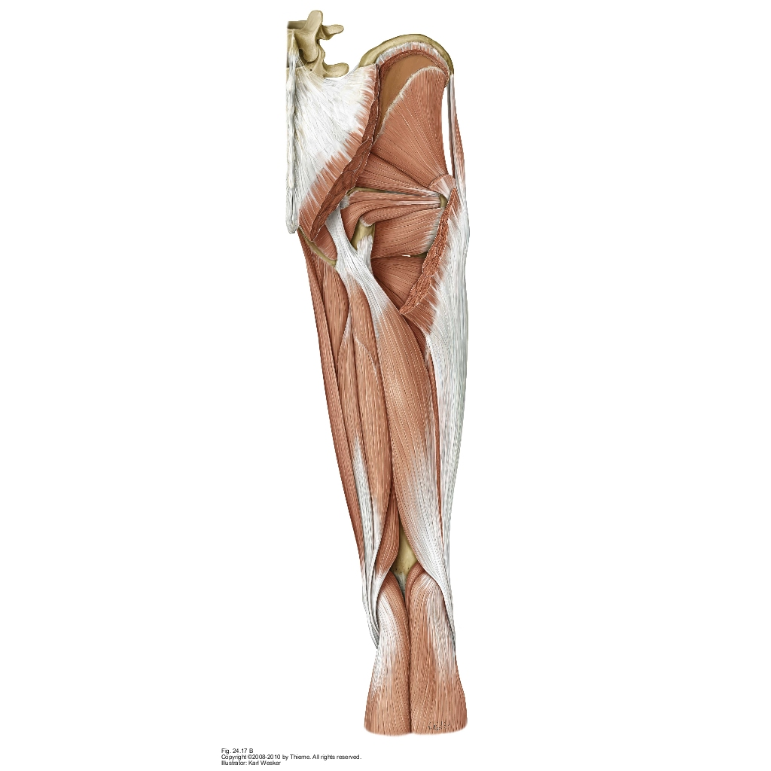
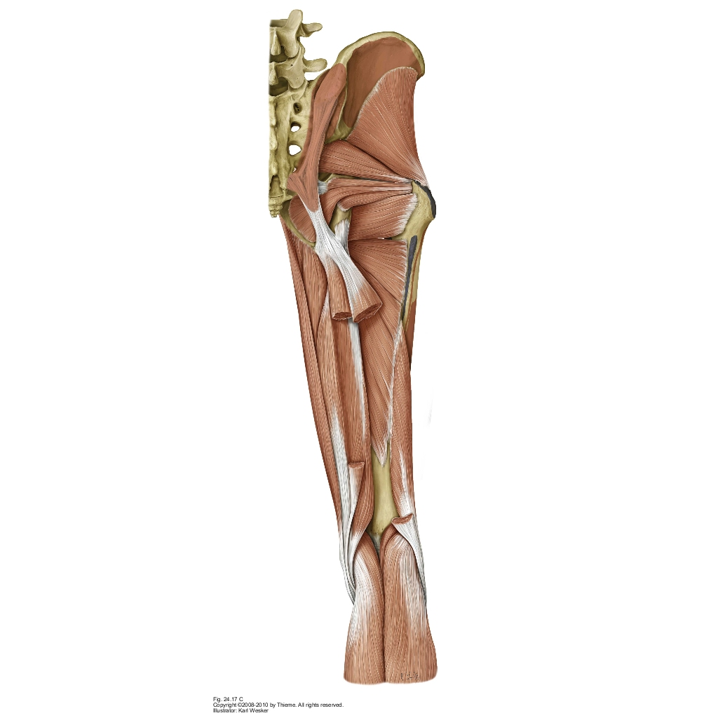
Muscles of the Thigh:
Posterior
The posterior region of the thigh’s main function is to extend the thigh and flex the leg. They include the biceps femoris, semimembranosus and semitendinosus. These four muscles are collectively known as the hamstrings.
As antagonists to the anterior quadraceps femoris and sartorius, these muscles actions are opposite to those in the anterior compartment. These actions include extending and stabilizing the hip and flexing and externally rotating the leg at the knee joint.
The biceps and semitendinosus tendons form the lateral and medial sides of the popliteal fossa, located on the backside of the knee
Short Head
Long Head

Slide 23
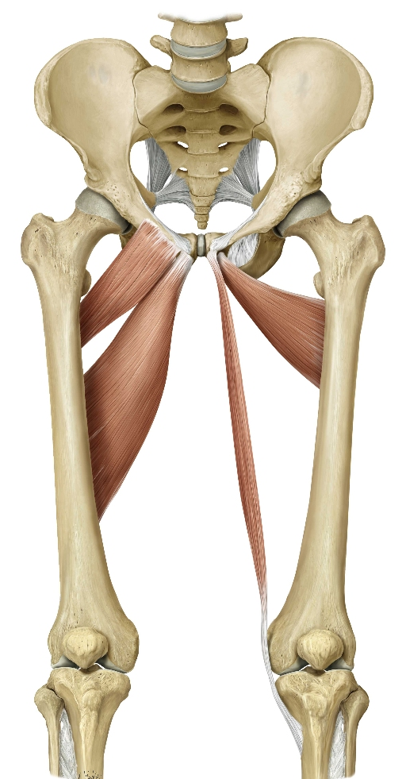
Muscles of the Thigh:
Medial Superficial
Pectineus
The medial portion of muscles in the thigh serve primarily to aDduct the thigh. These superficial muscles of this group include the pectineus, adductor longus, adductor brevis and gracilis. The adductor brevis is deep to adductor longus.
All four muscles originate on the pubic bone and all except for gracilis insert on different parts of the femur. The gracilis reaches around the knee and inserts on the tibia of the lower leg.
Innervation is supplied by both the femoral and obturator nerves branching from the lumbar plexus (L2, L3, L4).
Horseback riders can get what is called “rider’s leg” through overuse of thigh adductors causing discomfort. This discomfort is caused by ossification in the distal tendon of the adductor longus.
Adductor brevis
Gracilis
Adductor longus

Slide 24
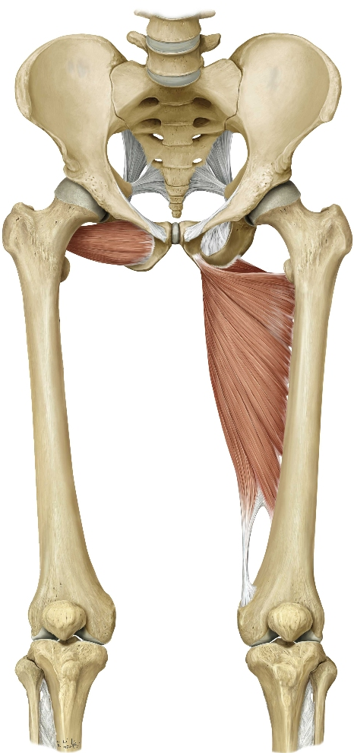
Muscles of the Thigh:
Medial Deep
The deep layer of medial thigh muscles include the obturator externus, adductor minimus and adductor magnus.
These three muscles also aDduct the thigh at the hip joint. They also play an important role in stabilizing the pelvis. The adductor magnus acts as both an adductor where it attaches to the linea aspera of the femur and a hamstring portion.
Note the empty space between the distal end of the femur and the adductor magnus tendon. This hole is called the adductor hiatus. It is here that the femoral artery travels through anteriorly, transitioning into the popliteal artery posteriorly.

Slide 25
Muscles of the Thigh
Muscles | Proximal Attachment | Distal Attachment
Sartorius | Iliac spine | Medial to tibial tuberosity
Rectus femoris |  | Tibial tuberosity
Vastus medialis | Linea aspera, intertrochanteric line | Both sides of tuberosity
Vastus lateralis | Linea aspera, greater trochanter
Vastus intermedius | Femoral shaft | Tibial tuberosity
Biceps Femoris [short heat] | Linea aspera and femur | Head of fibula
Biceps femoris [long head] | Ischial tuberosity and sacrotuberous ligament
Semimembranosus | Ischial tuberosity | Medial tibial condyle, oblique, popliteal ligament and popliteus fascia
Semitendinosus | Ischial tuberosity and sacrotuberous ligament | Medial to the tibial tuberosity in pes anserinus

Slide 26
Muscles of the Thigh (cont.)
Pectineus | Pectin pubis | Linea aspera and pectineal line
Adductor longus | Superior pubic ramus and anterior side of symphesis | Linea aspera
Adductor brevis | Inferior pubic ramus
Gracilis | inferior pubic ramus below the symphesis | Tibia
Obturator externus | Outer surface of obturator membrane | Trochanteric fossa of the femur
Adductor minimus | Inferior pubic ramus | Medial lip of the linea aspera
Adductor magnus | Inferior pubic ramus, ischial ramus and ischial tuberosity | Deep: linea aspera Superficial: adductor tubercle of femur

Slide 27
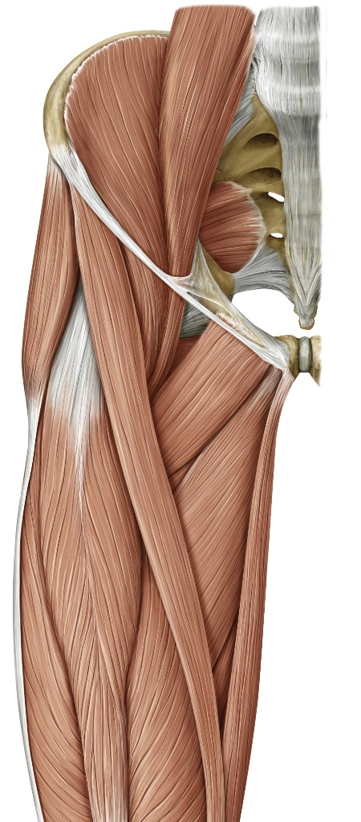
Inguinal ligament
The Femoral Triangle:
The Femoral Triangle is a portion of the upper thigh. The triangular shape is created with the combination of the inguinal ligament, adductor longus muscle and sartorius muscle.
Sartorius
Adductor longus

Slide 28
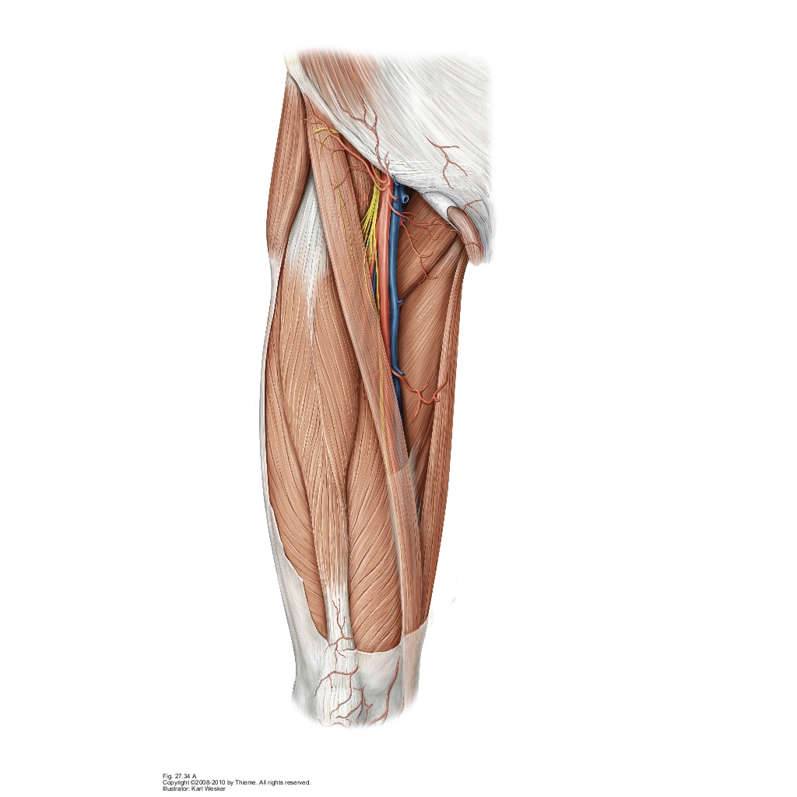
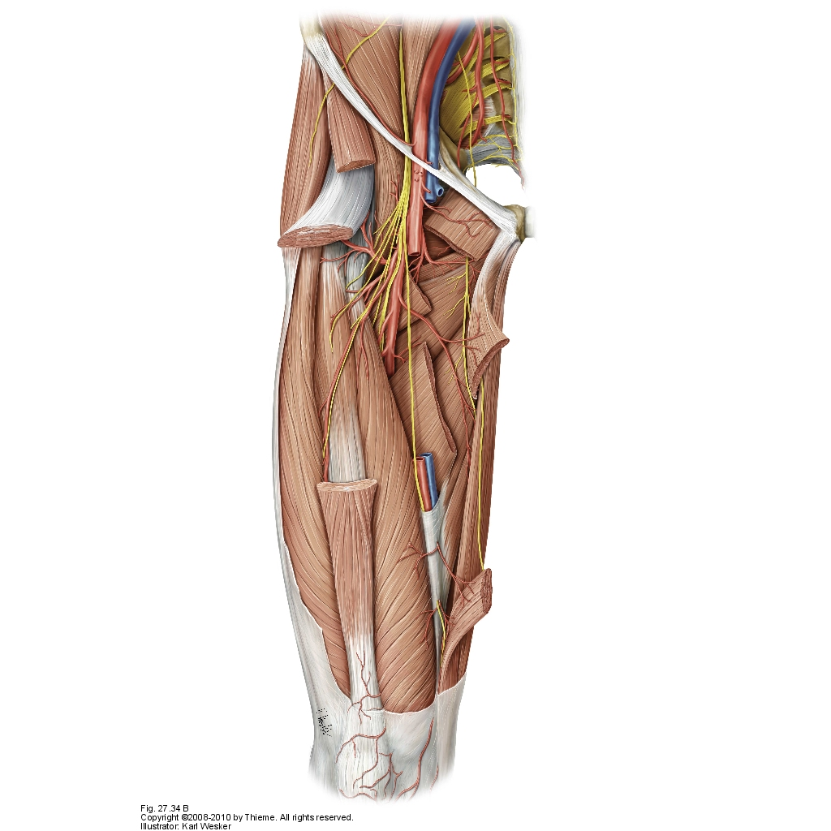
The Femoral Triangle (cont.):
Inguinal ligament
All the major blood supply and innervation of the lower limb travels through this region.
This includes the femoral artery, femoral vein, and femoral nerve.
All three pass behind the inguinal ligament then travel down the middle third of the thigh through the adductor canal.
The contents of the neurovascular bundle of the femoral traingle can be remembered (lateral to medial) by the acronym N.A.V.E.L., femoral Nerve, Artery, Vein, Empty space [that contains] Lymph. The femoral artery and vein are found within the femoral sheath while the nerve, wanting to avoid compression, is located outside the sheath.
The pulsations of the femoral artery are easily felt.
Sartorius
Adductor longus

Slide 29
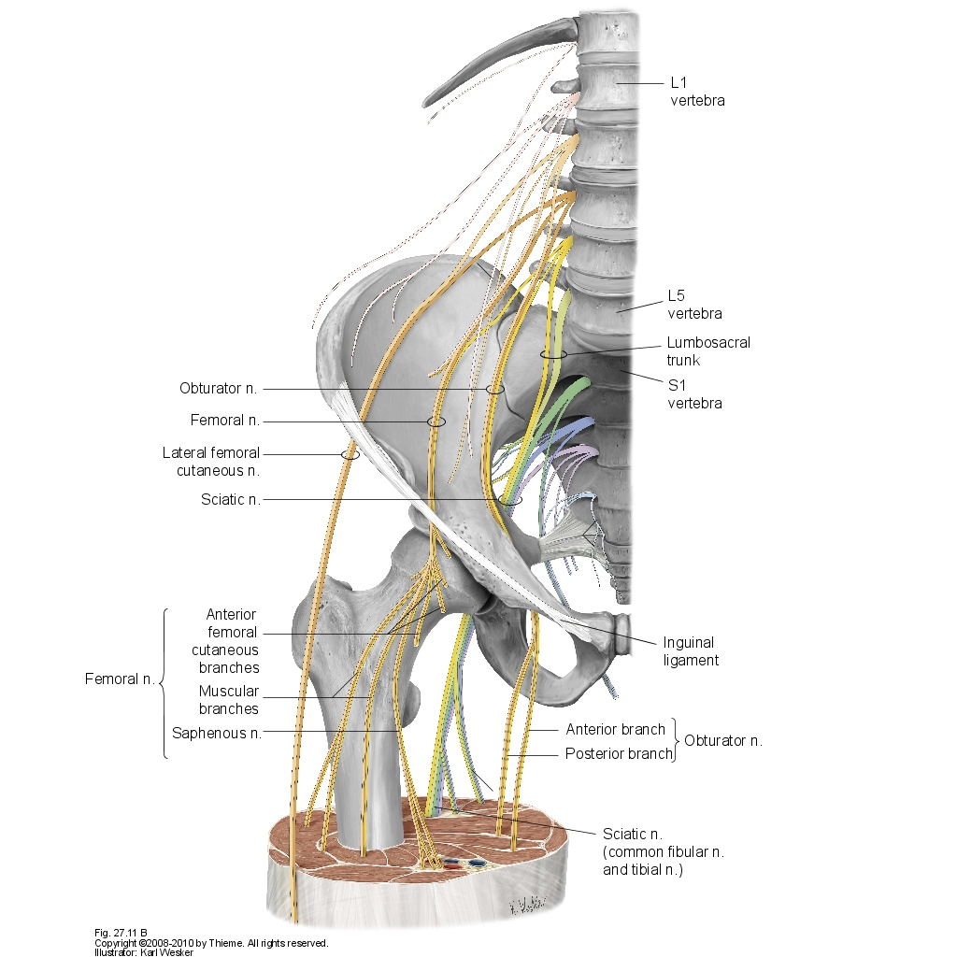
Innervation of the Thigh

Slide 30
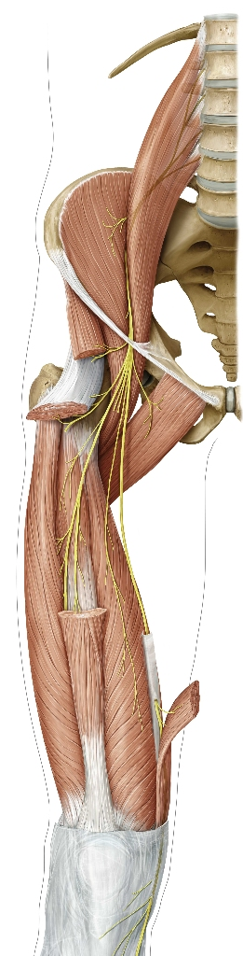
Innervation of the Thigh:
Femoral Nerve
The femoral nerve is the largest branch of the lumbar plexus (L2-L4) and enters into the thigh behind the inguinal ligament.
The nerve innervates the following muscles of the thigh:
Sartorius
Quadraceps femoris
- Rectus femoris
- Vastus medialis
- Vastus lateralis
- Vastus intermedius

Slide 31
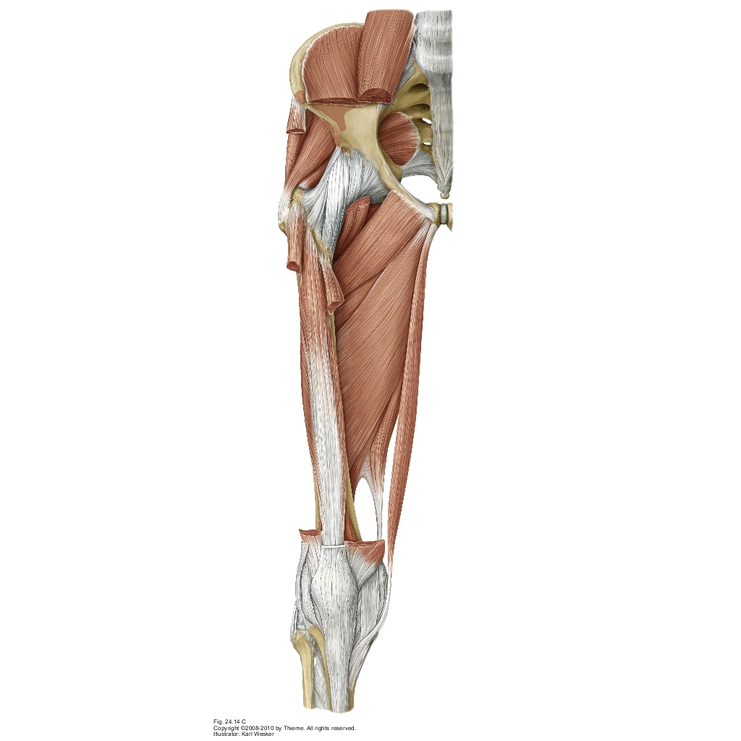
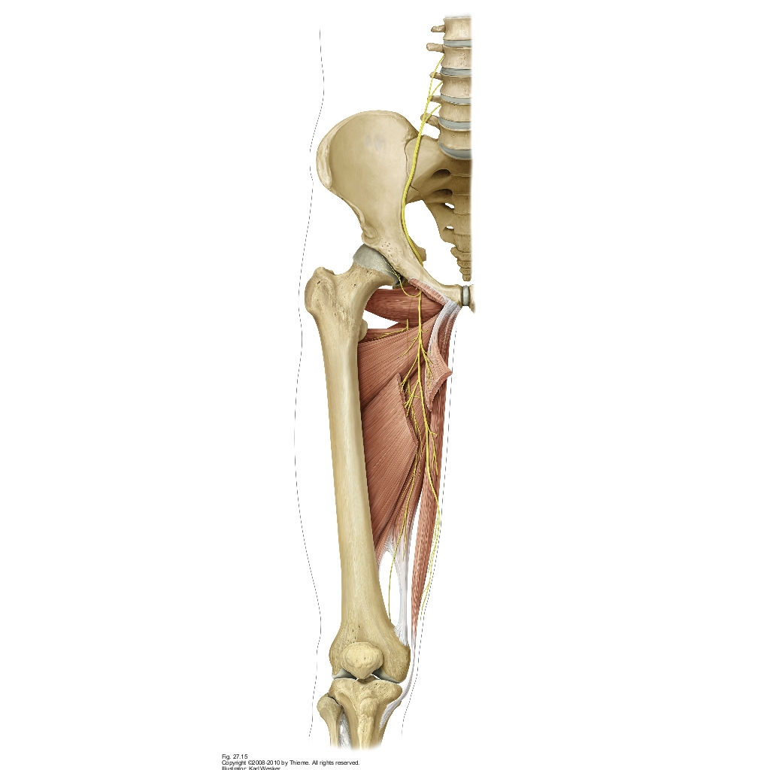
Innervation of the Thigh:
Obturator Nerve
The obturator nerve exits the spine at L2 to L4, passes through the obturator foramen and enters the thigh.
The nerve innervates the following muscles of the thigh:
Pectineus
Adductor longus
Adductor brevis
Gracilis
Adductor Magnus [deep part]
Adductor minimus*
Obturator externus*
* Note that some innervated muscles are not visible in the above image

Slide 32
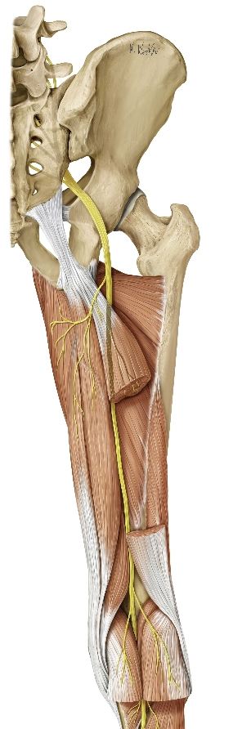
Innervation of the Thigh: Sciatic Nerve
[Tibial Division]
The sciatic nerve is the largest nerve in the human body, branches from the L4 to S3 regions and runs down the posterior region of the thigh. It divides just proximal to the popliteal fossa into the fibial and tibial divisions.
The tibial branch of the sciatic nerve innervates the following muscles of the thigh:
Adductor magnus [superficial]
Biceps femorus [long head]
Semimembranosus
Semitendinosus
Tibial Nerve

Slide 33
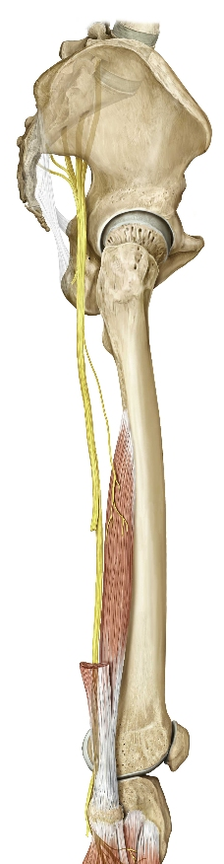
Innervation of the Thigh: Sciatic Nerve
[Common Fibular Division]
The sciatic nerve is fused in the thigh and splits just proximal to the popliteal fossa. Its two divisions are the tibial nerve and the common fibular nerve.
The common fibular branch of the sciatic nerve innervates the following:
biceps femorus [short head]
The biceps femorus originates at the linea aspera of the femur and attaches to the head of the fibula. The biceps femorus is unable to extend the hip like the other hamstrings, as it does not cross the hip joint. Instead its only responsibility is flexing the knee joint.
Common Fibular Nerve

Slide 34
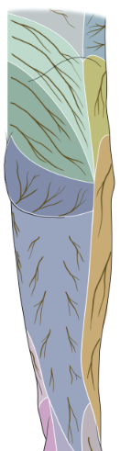
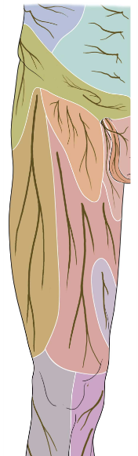
Innervation of the Foot:
Sensory Distribution
The sensory receptors of the anterior portion of the thigh are supplied by the femoral, iliohypogastric, gentofemoral, obturator, lateral femoral cutaneous and posterior femoral cutaneous nerves.
The femoral nerve supplies sensory innervation to the medial portion of the thigh apart from a small region near the knee which is supplied by the obturator nerve.
The genitofemoral nerve is responsible for the region of the femoral triangle. Proximal is the region supplied by the iliohypogastric nerve.
The lateral portion of the thigh is supplied by the lateral femoral cutaneous nerve. The posterior portion is supplied by the posterior femoral cutaneous nerve.

Slide 35
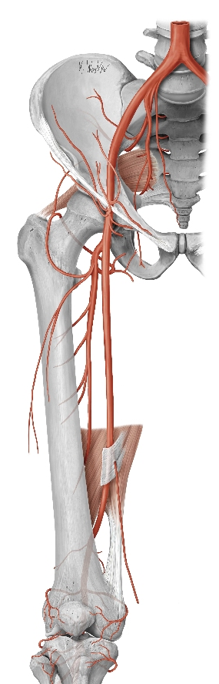
Arterial Supply to the Thigh
The abdominal aorta branches into two common iliac arteries in the lumbar region; these common branches divide into an internal and external branch. The external iliac artery is the primary blood supplier of the thigh (internal iliac supplies structures inside the pelvis).
From there the external iliac artery passes through the inguinal ligament and transitions into the femoral artery. Within the femoral triangle, the femoral artery branches into a large and smaller branch (deep femoral artery).
External iliac a.
Deep femoral a.
Femoral a.

Slide 36
Arterial Supply to the Thigh
External iliac a.
The medial and lateral circumflex arteries branch from the deep femoral artery to supply blood to the deep adductors and posterior muscles of the thigh.
The larger branch is labeled simply as the femoral artery. The femoral artery travels through the adductor hiatus and becomes known as the popliteal artery. The popliteal artery travels behind the knee, branches, changes names and continues down the posterior region of the lower leg towards the foot.
Lateral cercumflex femoral a.
Medial cercumflex femoral a.
Deep femoral a.
Femoral a.
Popliteal a.

Slide 37
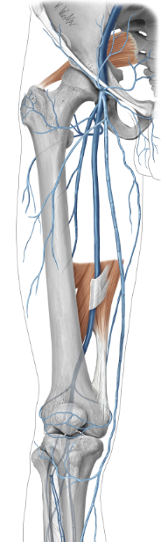
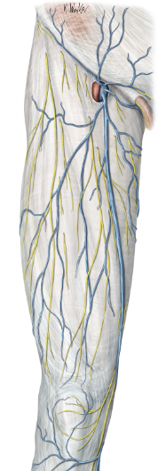
Venous Drainage of the
Thigh
Deep
Superficial
The main vein responsible for transporting blood from the thigh back to the heart is the long (great) saphenous vein. This vein originates at the dorsal venous arch of the foot and travels up the length of the lower limb. In the region of the femoral triangle, the vein merges with the femoral vein and deep femoral vein. The medial and lateral circumflex veins join the deep femoral vein before it converges with the deep femoral and dumps into the external iliac vein
Lateral circumflex femoral v.
Medial circumflex femoral vv.
Long saphenous
Deep femoral vein
Femoral vein
Popliteal vein

Slide 38
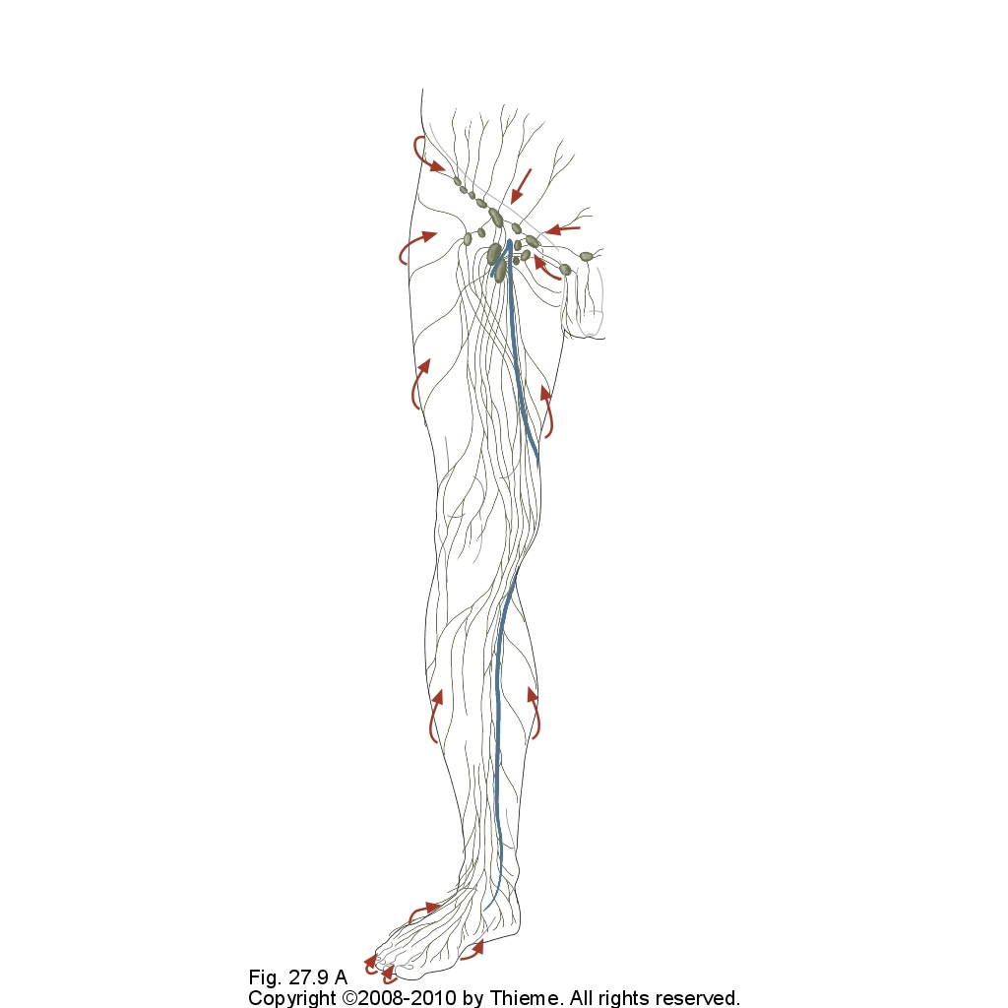
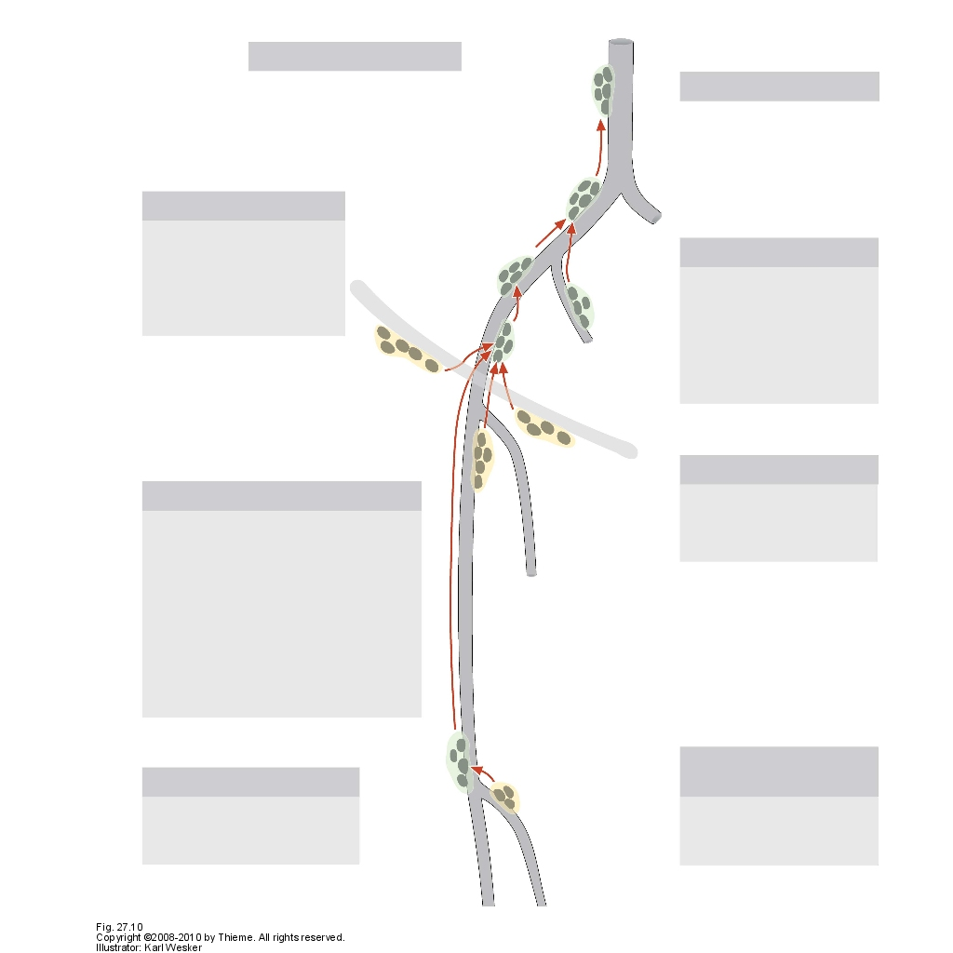
Lymphatic Structures of the Thigh
The red arrows pictured on the left show the general flow of lymph. Notice that the flow of lymph follows the same direction as the venous drainage of the thigh. Lymphatic fluid drains from superficial tissues, inward to deep tissues.
The popliteal lymph nodes receive dranage from the lower leg and foot.
Drainage from the skin, abdominal wall, lower back, gluteal region, bowel, anal region and external genitalia drain to the superficial inguinal lymph nodes.
The deep iliac lymphatic nodes receive drainage from the deep portions of the lower limb.
Deep iliac lymphatic nodes
Superficial inguinal lymph nodes
deep
Popliteal lymph nodes
superficial

Slide 39
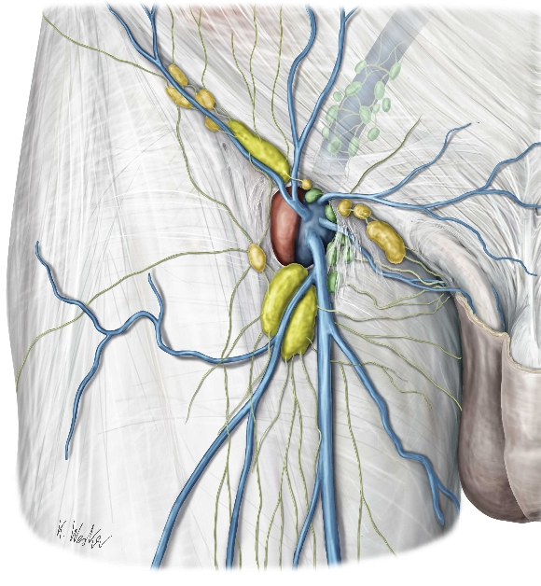
Lymphatic Structures of the Thigh
(cont.)
Deep lymph nodes
The femoral triangle has a major collection of superficial and deep lymph node in which the lymph collected from the lower limb passes before heading back towards the heart.
Superficial lymph nodes

Slide 40
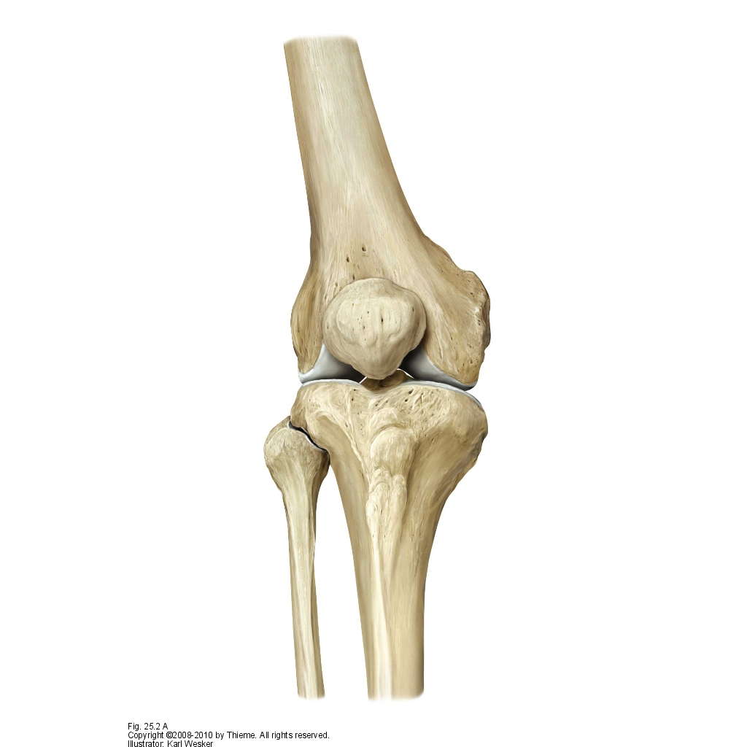


The Knee

Slide 41

The Knee: Stability
Due to the poor construction of the knee joint, its stability depends primarily on the muscles and ligaments that surround it. The quadriceps femoris is an important stabilizing group of muscles for the knee.
Illustrating the poor evolutionary development of the human knee joint, used for bipedal walking, its construction is commonly compared to two balls sitting atop a warped table.
The knee is most stable when extended. In this position the articulations of the knee are most congruent.

Slide 42


The Knee: Injury
Knee injuries are very common in athletes. Damage is most commonly done to the soft tissues (ligaments and cartilage).
The medial and lateral collateral ligaments restrict the knee’s range of motion from side-to-side. The medial collateral ligament can easily be sprained or torn if too much inward force is applied. Damage to the lateral collateral ligament is possible yet usually only occurs in congruence with other ligament damage.
FORCE
Right knee; anterior view

Slide 43


The Knee: Menisci
The medial and lateral condyles of the femur rest on the medial meniscus and lateral meniscus of the knee, respectively. The menisci are articular cartilage that act as shock absorbers.
The menisci are easily injured during sports or while lifting heavy objects. Injuries occur most often to the medial meniscus and is the result of a sudden extension or rotation of the knee while the foot is planted. The two types tears include a bucket-handle tear and a radial tear (pictured as a radial tear of the posterior horn).
The ACL is a ligament commonly talked about in reference to sports injury and results from the same general scenario.
Anterior cruciate ligament (ACL)
Anterior
Posterior
Posterior cruciate ligament

Slide 44

Popliteal Fossa
Located behind the knee is the diamond shaped popliteal fossa. This region is visible and palpable. The region is made proximally by the tendons of the posterior muscles of the thigh, including the biceps femorus and semimembranosus, and distally by the lateral and medial heads of the gastrocnemius muscle and the plantaris and popliteus muscles of the lower leg (not visible).
This region holds many important structures including:
Common peroneal nerve
Tibial nerve
Popliteal vessels
Lymph nodes
Bursae
All structures are cushioned by fat. In addition, the small saphenous empties into the popliteal vein.

Slide 45


The Knee: Arterial Supply
Adductor hiatus
Adductor canal
The popliteal artery provides the bones and muscles of the knee with its necessary blood supply.
The popliteal artery originates from the femoral artery that travels anterior to the adductor magnus of the thigh, down the adductor canal and through the adductor hiatus, transitioning to the posterior region of the knee joint. The popliteal artery branches and wraps around the knee allowing for sufficient blood supply.
Once passing the knee, the popliteal artery forks into the anterior tibial artery and the posterior tibial artery. The fibular artery branches from the posterior tibial artery.
Posterior
Anterior

Slide 46
The Lower Leg
The lower limb is composed of the fibula and tibia.
The lower leg is much more constricted in comparison to the range of motion of the thigh. The primary function of the muscles in the lower leg is movement of the the bones in the foot. Bound together by the interosseous membrane, the tibia and fibula are virtually immobile.
We will begin understanding the lower leg by covering the surface anatomy of the fibula and tibia.

Slide 47


Tibia & Fibula: Proximal View
Lateral condyle
Medial condyle
The proximal end of the tibia has a lateral and a medial condyle that hold the medial and lateral menisci of the knee. The tibial tuberosity is where the patellar ligament attaches.
Head of fibula
Neck of fibula
Posterior
Anterior

Slide 48


Tibia & Fibula: Proximal View
Intercondylar eminence
The intercondylar eminence articulates with the intercondylar notch of the femur and is capable of fractures. The soleal line is a prominent ridge found on the posterior side of the tibia and serves as an attachment point for muscles and facia of the posterior compartment of the lower leg, including insertion of the popliteus and orgin of the soleus, flexor digitorum longus and tibialis posterior.
The interosseous membrane is a fibrous fascia, like that found between the radius and ulna, connecting the two bones. This membrane is opened at small point to allow for passage of blood vessels. It divides the leg into posterior and anterior compartments.
Head of tibia
Soleal line
Interosseous membrane

Slide 49

Tibia & Fibula: Distal View
The distal end of the tibia and fibula make up the ankle bones, formally known as the lateral and medial malleolus.
The tibiofibular syndesmosis is a non-cartilaginous joint formed by the tibia and fibula. Many ligaments attach at this point, stabilizing the ankle joint. Syndesmosis sprains are common and if severe enough, may require temporary screws (shown in grey) for immobilization and healing.
Medial malleolus
Tibiofibular syndesmosis
Anterior
Lateral malleolus
Anterior
Posterior

Slide 50
Tibia & Fibula: Distal View
The distal end of the fibula and tibia articulate with the talus of the foot at the ankle joint. The ankle is a synovial joint.
The lateral malleolar fossa is a rough depression in the fibula that provides a spot for attachment of the posterior talofibular and the transverse tibiofibular ligaments.
Lateral malleolus
Medial malleolus
Lateral malleolar fossa
Posterior

Slide 51


Cross Section of the Lower Leg
Interosseous membrane
Lateral
Compartment
Facia extends inward to separate the lower leg into an anterior, posterior and lateral compartment.
The posterior compartment, commonly referred to as the calf muscles, makes up the majority of the lower leg and plantarflex the foot. The anterior and lateral compartments are responsible for dorsiflexion (extension), supination and pronation (eversion) of the foot.
Anterior
Comp.
Posterior
Compartment

Slide 52


Muscles of the Lower Leg: Anterior
The four muscles of the anterior compartment are the tibialis anterior, extensor hallucis longus, extensor digitorum longus and fibularis tertius. As suggested by the names, the muscles of the anterior compartment are extensors that extend the digits of the toes and act on the ankle to dorsiflex the foot as a whole.
These muscles originate on the tibia and fibula of the lower leg and insert on the bones of the foot. Due to this setup, there are two band-like thickenings of fascia, referred to as retinacula, that restrain the muscles at the ankle in order to avoid bowstringing during dorsiflexion.
Superior extensor retinaculum
Inferior extensor retinaculum

Slide 53


Muscles of the Lower Leg: Lateral
The lateral compartment contains the fibularis longis and fibularis brevis muscles.
The fibularis muscles are responsible for eversion of the foot at the ankle. Essentially they serve as major balancing tools while walking or standing in place. For example, if one is standing on one foot, and the body feels as though the center of gravity is shifting medially, the fibularis muscles contract, pressing the medial portion of your foot downward and pulling the center of gravity back to the center of the limb.
These muscles are innervated by the posterior division of the spinal nerves yet due to their placement, act as evertors of the foot.

Slide 54





Muscles of the Lower Leg:
Posterior [superficial]
The superficial part of the posterior compartment of the lower leg consists of the gastrocnemius, soleus and plantaris. The gastrocnemius and soleus, referred to together as the triceps surae, share a common tendon, the Achilles’ (calcaneal) tendon. This tendon is the strongest in our body.
Contraction of the posterior compartment results in plantarflexion of the foot. It is this action that “pushes” a person forward while walking or up when jumping. Most of the force is exerted on the ball of the foot.
Lateral head
Medial head
Achilles’ tendon

Slide 55



Muscles of the Lower Leg:
Posterior [deep]
The tibialis posterior, flexor digitorum longus, flexor hallucis longus and popliteus muscles make up the deep portion of the posterior compartment of the lower leg. The popliteus acts as a stabilizor for the knee while the other three muscles assist the superficial posterior compartment with plantarflexion and flexion of the toes.
Due to the arrangement of the deep muscle tendons to the foot in comparison to the Achilles’ tendon of the superficial muscles, the deep muscles contribute a very small amount to the overall force applied when flexion occurs.
The next slide will identify the order in which these muscles pass through medial malleolus.
* “Longus” muscle tendons usually attach at the tip of a joint while their “brevis” counterparts usually attach more at the joint.

Slide 56
Muscles of the Lower Leg
Muscle | Proximal Attachment | Distal Attachment
Fibularis longus | Head of fibula and proximal surface | Medial cuneiform, 1st metatarsal
Fibularis brevis | Distal half of fibula, intermuscular septa | 5th metatarsal
Tibialis anterior | Upper two thirds of tibia | Medial cuneiform, 1st metatarsal
Extensor hallucis longus | Middle third of fibula | 1st toe
Extensor digitorum longus | Head and anterior border of fibula and lateral condyle of tibia | 2nd to 5th toes
Extensor digitorum longus | Distal fibula | 5th metatarsal

Slide 57
Muscles of the Lower Leg (cont.)
Muscle | Proximal Attachment | Distal Attachment
Gastronemius | Medial and lateral epicondyles of the femur | Calcaneal tuberosity
Soleus | Head and neck of fibula and soleal line of tibia
Plantaris | Lateral epicondyle of fibula
Tibialis posterior | Interosseus membrane | Navicular tuberosity, cuneiforms, 2nd to 4th metatarsals
Flexor digitorum longus | Middle third of tibia | 2nd to 5th distal phalanges
Flexor hallucis longus | Distal fibula, adjacent interosseous | 1st distal phalanx
Popliteus | Lateral femoral condyle, posterior horn of lateral meniscus | Posterior tibial surface

Slide 58


Muscles of the Lower Leg:
Tarsal Tunnel
In the order you come upon them….
Tom, Dick, And Very Nervous Harry
Tibialis posterior muscle
flexor Digitorum longus muscle
posterior tibial Artery
posterior tibial Vein (not shown)
tibial Nerve
flexor Hallucis longus muscle

Slide 59

Innervation of the Lower Leg:
Superficial Fibular Nerve
The superficial fibular nerve innervates the lateral compartment of the lower leg. It is one of two branches of the common fibular nerve (a branch of the sciatic nerve).
The nerve innervates the following muscles of the lower leg:
Fibularis longus
Fibularis brevis

Slide 60


Innervation of the Lower Leg:
Deep Fibular Nerve
The deep fibular nerve innervates the anterior compartment of the lower leg. It along with the superficial fibular nerve, make up the two branches of the common fibular nerve.
The nerve innervates the following muscles of the lower leg:
Tibialis anterior
Extensor hallucis longus
Extensor digitorum longus
Fibularis tertius
Injury to this nerve would
result in footdrop (disability
dorsiflex/clear the foot while walking).

Slide 61

Innervation of the Lower Leg:
Tibial Nerve
Along with innervating 4 muscles of the posterior thigh, the tibial nerve is in charge of innervating the entire posterior compartment of the lower leg. It branches directly from the sciatic nerve at variable distances above the popliteal fossa.
The nerve innervates the following muscles of the lower leg:
Triceps surae
Gastrocnemius
Soleus
Plantaris
Tibialis posterior
Flexor digitorum longus
Flexor hallucis longus
Popliteus

Slide 62


Innervation of the Lower Leg:
Sensory Distribution
The femoral and sciatic nerves supply the lower leg with its sensory innervation.
The femoral nerve continues from the thigh and is responsible for sensory innervation of the medial, anterior portion of the lower leg. The lateral portion is supplied by the common fibular division of the sciatic nerve.
The tibial division of the sciatic nerve supplies the posterior region of the lower leg and continues downwards towards the plantar side of the foot.

Slide 63


Arterial Supply of the Lower Leg
Popliteal a.
Blood is supplied to the lower leg from the three branches of the popliteal artery. These branches include the posterior and anterior tibial arteries and the fibular artery.
The posterior tibial artery and fibular artery are the main blood suppliers of the posterior and lateral compartments of the lower leg while the anterior tibial artery supplies the anterior compartment.
These arteries continue on into the foot where they terminally branch and provide nutrients.
Posterior tibial a.
Fibular a.
Anterior tibial a.

Slide 64


Venous Drainage of the Lower Leg
Deep
Superficial
Short saphenous v.
The veins of the lower leg converge into the popliteal vein of the knee. The two major veins are the short saphenous and the posterior tibial veins, both originating in the foot. The fibular vein is located on the lateral side of the lower leg and merges into the posterior tibial vein. The anterior tibial vein is located between the proximal portions of the short saphenous and the posterior tibial veins.
Anterior tibial v.
Fibular vv.
Posterior tibial vv.

Slide 65


Lymphatic Drainage of the Lower Leg
The red arrows on the right show the general flow of lymph in the lower leg. The direction of flow follows that of the veins.
Lymph from the superficial and deep lymphatic vessels of the lower leg drain into the superficial and deep popliteal lymph nodes respectively. From there, the flow continues on to the deep inguinal lymph nodes located in the femoral triangle of the upper thigh.

Slide 66


The Ankle
Joint innervation and blood supply is done by the nerves and arteries that pass by it.
In the case of the ankle, posterior arterial supply is from the posterior tibial artery and innervation from the tibial nerve. Anterior blood supply is given from the anterior tibial artery and innervation from the deep fibular nerve.
Posterior tibial artery
Anterior tibial artery
Tibial nerve

Slide 67


Clinical: Ankle Sprain
The most common ankle related injuries are ankle sprains with roughly 1 million visiting the doctor about sprain related injury. Ankle sprains are common in sports yet can also happen while carrying out everyday tasks. Injuries in which the foot is inverted rather than everted are more common. This action causes the ligaments of the ankle, more specifically the calcaneo fibular ligament and anterior talofibular ligament, to be hyper-stretched and possibly tear. Swelling, pain and redness are common symptoms of ankle sprains.
Inversion of the foot at the ankle joint
http://www.emedicinehealth.com/ankle_sprain/page2_em.htm
http://www.shakadula.com/p90x/?cat=1

Slide 68



Major Ligaments of the Ankle
Three major ligaments of the ankle joint include the deltoid ligament, posterior tibiofibular ligament and calcaneofibular ligament. What is referred to as the deltoid ligament is actually a group of four smaller ligaments that stabilize the ankle from over everting the foot.
These three major ligaments are what are commonly injured or torn when a person sprains their ankle.
Medial
Posterior
Lateral

Slide 69

The Foot
The foot is the most weight baring region of the entire body and is constructed in a way to withstand a great amount of pressure as well as allow for balance while standing or walking.
The foot is divided into thee sections, the tarsus, metatarsus and forefoot. These bones are analogues to the carpal bones, metacarpals and phalanges of the hand.

Slide 70

Bones of the Foot: Tarsus
The tarsus of the foot includes seven bones: the talus, calcaneus, cuboid, navicular and three cuneiforms (lateral, intermediate and medial).
The talus is the bone in which articulates with the tibia and fibula, forming the ankle joint. The talus receives all the wait of the body and disperses it to the other bones of the foot through multiple joints in the foot.
The calcaneus forms the heel of the foot and is the first to hit the ground when walking. It articulates with the talus and cuboid.
The navicular articulates with the three cuniform bones and the talus. It is named navicular because of its resemblance to a small boat.
Intermediate cuneiform
Lateral cuneiform
Medial cuneiform
Navicular
Cuboid
Talus
Calcaneus

Slide 71
Bones of the Foot: Metatarsus
The metatarsus of the foot includes the five metatarsals of the toes:
1st metatarsal
2nd metatarsal
3rd metatarsal
4th metatarsal
5th matatarsal
The bones are numbered as they are positioned in the foot, from medial to lateral.
These bones are similar to the metacarpal bones of the hand.
The second and third metatarsal are fixed while walking and because of this can easily experience a stress fracture after prolonged use.
1
2
3
4
5

Slide 72
1
2
Bones of the Foot: Forefoot
3
4
5
The forefoot consists of the phalanges (proximal, middle and distal). These bones construct the visible digits of the foot and are able to flex, extend, abduct and adduct.
The phalanges are very similar in shape yet differ in size and length.
Notice that there is no middle philanx in digit one.

Slide 73


Joints of the Foot
The foot is made up of 26 individual bones and 33 joints in which they articulate.
The transverse tarsal joint is located in the tarsus of the foot and is made up of the talonavicular joint and calcaneocuboid joint.
Amputation of the foot at this joint is referred to as a Chopart Amputation.
Calcaneus (articular surface for cuboid)
Navicular (articular surface for talus)
Cuboid
Talus
Transverse tarsal joint

Slide 74


Ligaments of the Foot
The bones of the foot are connected by many ligaments, the major ones consisting of the Plantar calcaneonavicular ligament (spring ligament), long plantar ligament and the plantar aponeurosis.
The plantar calcaneonavicular ligament extends from the talus to the navicular and helps with the transfer of weight from the talus while walking, giving support and helping to maintain the arch. A lax ligament would be evident in a collapsing arch or the extreme, known as “flatfoot” (lacking an arch).
The long plantar ligament runs from the calcaneous to the cuboid and metatarsals 3, 4 and 5, creating a tunnel where the fibularis longus tendon passes through.
The plantar aponeurosis ligament runs from the calcaneous, alongside the flexor digitorum brevis muscle, and attaches to the phalanges. Its sole purpose is to maintain the arch of the foot
Plantar View

Slide 75

Muscles of the Foot:
Intrinsic Muscles of the Dorsum
The intrinsic muscles of the dorsum include the two muscles extensor digitorum brevis and extensor hallucis brevis. These muscles are responsible for extending the the 1st through 4th toe.
The extensor digitorum brevis attaches to the base of the middle philanges of the 2nd to 4th toe while the extensor hallucis brevis attaches to the proximal philanx of the 1st toe at the dorsal aponeurosis.
Muscles labeled “brevis”, in contrast to “longus”, attach at a joint (i.e. metatarsophalangeal joints and proximal interphalangeal joints). Muscles labeled “longus” attach to the tip of the joint.

Slide 76

Intrinsic Muscles of the Foot: Layer 1
(Superficial)
Abductors of the foot
The superficial intrinsic muscles of the sole are found on the underside of the foot, originating at the calcaneal tuberosity and attaching at different points on the phalanges. These muscles include the abductor hallucis, flexor digitorum brevis and abductor digiti minimi.
These muscles are primarially responsible for flexion of the foot and support of the longitudinal arch. As suggested by the name, the abductor hallucis and abductor digiti minimi are responsible for aBducting the 1st and 5th toes, respectively.
Plantar View

Slide 77

Intrinsic Muscles of the Foot:
Layer 2
The second layer of muscles are the main flexors of the toes. The quadratus plantae originates on the calcaneal tuberosity and inserts on the flexor digitorum longus tendon, redirecting the pull of the tendon. There is no homolog to the quadratus plantae muscle in the hand.
The four lumbricles of the foot connect the flexor digitorum longus tendon to toes 2 through 5. They attach more proximally than the flexor digitorum longus tendon and therefore flex the toes to a lesser degree. They are also capable of adducting toes 2 through 5 towards the big toe.
Plantar View

Slide 78

Intrinsic Muscles of the Foot:
Layer 3
The third layer of muscles also flex the toes at the metatarsophalangeal (MTP) joints of the foot. These muscles include the flexor hallucis brevis, adductor hallucis and flexor digiti minimi brevis.
The flexor hallucis brevis has two heads, one medial and one lateral, both responsible for flexing the MTP joint and supporting the longitudinal arch.
The adductor hallucis muscle has two heads as well, a transverse and an oblique head. Both act primarily on the big toe, flexing and adducting. The transverse head helps in supporting the transverse arch while the oblique head aids in longitudinal arch support.
Flexor digiti minimi brevis runs along the 5th metatarsal and is responsible for flexing the MTP joint of the little toe.
Plantar View

Slide 79


Intrinsic Muscles of the Foot:
Layer 4
The fourth layer of the sole includes the seven plantar and dorsal interossei.
There are three plantar interossei muscles located on toes 3, 4 and 5, laterally to the respective dorsal interossei. These three muscles flex, extend and adduct the 3rd to 5th toes.
There are four dorsal interossei muscles originating on all 5 metatarsals and effecting phalanges 2 through 4. These four muscles are capable of flexing, extending toes 2 through 4, and abducting only the 3rd and 4th toes.
Plantar View

Slide 80

Innervation of the Foot:
Lateral and Medial Plantar Nerve
The lateral and medial plantar nerves provide innervation to all the muscles of the plantar side of the foot.
Medial plantar nerve
Lateral plantar nerve

Slide 81
Muscles of the Foot
Muscle | Proximal Attachment | Distal Attachment
Extensor digitorum brevis | Dorsal surface of calcaneus | 2nd to 4th toes
Extensor hallucis brevis |  | 1st toe
Abductor hallucis | Medial process of calcaneal tuberosity | 1st toe
Flexor digitorum brevis | Medial tubercle of calcaneal tuberosity, plantar aponeurosis | 2nd to 5th toes
Abductor digiti minimi |  | 5th toe, 5th metatarsal
Quadratus plantae | Calcaneal tuberosity | Flexor digitorum longus tendon
Lumbricals (four muscles) | Flexor digitorum longus tendons | 2nd to 5th toes
Flexor hallucis brevis | Cuboid, lateral cuneiforms, and plantar calcaneocuboid ligament | 1st toe

Slide 82
Muscles of the Foot (cont.)
Muscle | Proximal Attachment | Distal Attachment
Adductor hallucis | Oblique head: 2nd to 4th metatarsals Transverse head: MTPs of 3rd to 5th toes, deep transverse metatarsal ligament | 1st proximal phalanx
Flexor digiti minimi brevis | 5th metatarsal, long plantar ligament | 5th toe
Opponens digiti minimi | Long plantar ligament, fibularis longus | 5th metatarsal
Plantar interossei (three muscles) | 3rd to 5th metatarsals | 3rd to 5th toes
Dorsal interossei (four muscles) | 1st to 5th metatarsals (has two heads) | 1st interosseus: 2nd proximal phalanx 2nd to 4th interossei: 2nd to 4th proximal phalanges, 2nd to 4th toes

Slide 83

Innervation of the Foot:
Deep Fibular Nerve
The deep fibular nerve innervates the two intrinsic muscles of the dorsum. These muscles include the extensor digitorum brevis and the extensor hallucis brevis.

Slide 84
Innervation of the Foot:
Sensory Distribution
The sensory receptors of the anterior (top) surface of the foot are primarially supplied by the common fibular nerve while the tibial nerve receives sensory signals from the bottom of the foot.
The superficial fibular nerve (medial dorsal cutaneous nerve and intermediate dorsal cutaneous nerve) receives sensory information for the majority of the dorsal surface of the foot. The plantar portion of the foot is sensed by the proper plantar digital nerve.

Slide 85

Arterial Supply to the Foot
The anterior tibial artery is the major blood supplier to the dorsal region of the foot. Originating from the anterior tibial artery, traveling through the tarsal tunnel (Tom, Dick And Very Nervous Harry) and terminating at the dorsalis pedis artery, the lateral and medial plantar arteries provide sufficient nutrients to the bottom of the foot.
Anterior/Dorsal View
Plantar View

Slide 86


Venous Drainage of the Foot
Deep
Superficial
Plantar digital veins
The plantar digital veins begin in the toes and run along the lateral side of toes 1-4. The plantar digital vein of the 5th toe is located medially. The veins continue to follow the metatarsals towards the heel as the plantar metatarsal veins. The veins of digits 2 through 5 converge to form two arches known as the dorsal venous arch and plantar venous arch. The dorsal venous arch gives rise to the long (great) saphenous vein. Digit one drains into the medial plantar vein. The short saphenous vein supplies drainage laterally to and originates around the 5th metatarsal.
Plantar metatarsal veins
Dorsal venous arch
Plantar venous arch
The network of veins located on the top of the foot are known collectively as the dorsal venous network.
Long saphenous vein
Short saphenous vein
Lateral plantar vein

Slide 87


Venous Drainage of the Foot:
Superficial Veins
The blood flows….
Notice the lack of superficial veins on the bottom of the foot…pressure…
Differentiate small saphenous and great saphenous.
Anterior
Posterior

Slide 88

Lymphatic Drainage of the Foot
The lymph of the foot travels from the plantar region to the anterior region of the foot then upwards towards the lower leg and into the popliteal lymph nodes.
As with the rest of the body, the lymph follows the general venous flow of the foot.
Anterior
Posterior

Slide 89
For extra visual practice check out:
http://www.getbodysmart.com/index.htm

